Slide 1
QED The Fourth Mode of Heat Transfer?
Thomas Prevenslik
QED Radiations
Discovery Bay, Hong Kong, China

Slide 2
Heat Transfer
Heat transfer proceeds by 3 modes:
Conduction
Radiation
Convection
Proposal
QED is the Fourth Mode of Heat Transfer
QED = Quantum Electrodynamics

Slide 3
Background
Interest in nanocoatings !!!
ZnO nano coating on aluminum improved BHT 4-10 times
Oregon State University, 2010
BHT = Boiling Heat Transfer
Graphene on silicon dioxide Improved BHT > 2 times
Korea, 2014

Slide 4
Mechanism
In nanocoatings, QED converts heat into the surface to EM radiation because QM precludes conservation of the heat by an increase in temperature.
EM = Electromagnetic
QM = Quantum Mechanics

Slide 5
QED Heat Transfer
Natural convection
QED
Radiation
Macro Coating Temperature increase
Nano Coating < 100 nm
No temperature increase
Substrate
Heat
Nano Coating conserves heat without a temperature increase as high frequency QED radiation bypasses natural convection to enhance heat transfer

Slide 6
Theory
Heat Capacity of the Atom
EM Confinement
QED Radiation

Slide 7

Heat Capacity of the Atom
$$E= \frac{\frac{hc}{λ}}{exp\left(\frac{hc}{λkT}\right)−1}$$
Nanoscale
Macroscale
QM: kT → 0 at nanoscale
Classical physics
1912 → Debye’s phonons → hυ = kT → valid for λ > 100 μm
Today, phonons used in nanostructures !
Debye’s phonons and discrete MD invalid at the nanoscale
1950 → Teller & Metropolis MD → PBC → valid for λ > 100 μm
Today, MD used in discrete nanostructures !

Slide 8
EM Confinement
Nano structures have high surface-to -volume ratio.
Surface absorption places interior atoms under high EM confinement, but QM precludes temperature increase.
QED conserves the trapped energy to EM radiation.
QED: EM energy into QM box → Create QED radiation at λ/2 = d
f = (c/n)/λ λ = 2d E = h f
Nano
Coating
Heat
QED
Radiation
QED
Radiation
Heat
Body
No
Temperature
increase
Surroundings
QED
d = λ/2
QED → 100 % efficiency >> LEDs !!!

Slide 9
QED Radiation Emission
UVC
50 nm ZnO

Slide 10
Applications
Thin Films
Nanoelectronics
Turbine Blades
EUV Lithography
Water Purification

Slide 11
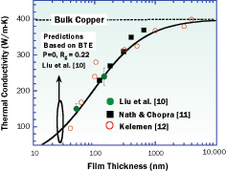
Thin Films
Cooling by QED radiation in thin films began 50 years ago
Data is misinterpreted → No reduced thermal conductivity
Heat loss by QED radiation beyond the UV was not included in the thin film heat balance.
If the QED radiation loss is included in the balance, the conductivity remains at bulk.
Exclusion of QED radiation from the heat balance is understandable as the UV would normally not be observed

Slide 12
Nanoelectronics
QED radiation cools nanoelectronics naturally,
just make circuit elements submicron
QM requires the heat capacity of
the atom to vanish → Joule heat
cannot produce hot spots
But Charge is created → 1/f Noise
Nanoelectronics operate in clean room environments, and therefore air contaminants are unlikely to foul the coating and degrade the cooling

Slide 13
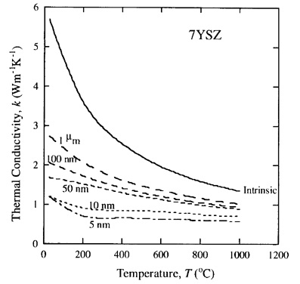
Turbine Blades
Gas turbine blades are coated with TBC comprising nano grains to insulate the blade from hot combustor gases.
TBC = thermal boundary coating.
Nano coatings do not insulate the blade from high temperature, but radiate the heat to the surroundings
Reductions in thermal conductivity with nano grains is based on phonon scattering analysis ?
Turbine blade QED coatings differ from those in nanoelectronics because it is difficult, if not impossible to keep the coatings clean from fouling by combustor gas residues.

Slide 14
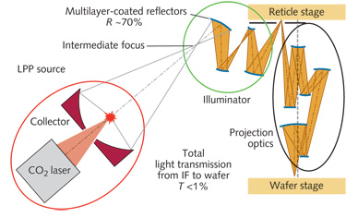
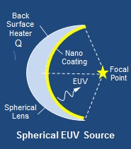
EUV Lithography
Difficulty in Moore’s law at 13.5 nm is LPP lithography.
LPP = laser produced plasma
Based on classical physics, LPP requires high temperature → EUV light using CO₂ lasers focused by large mirrors
QED lithography is far simpler
QED uses a small spherical glass lens provided on the front surface with a nanoscale ZnO coating to convert heat into a EUV light source. Lasers are not required.
QED radiation λ = 2 n d
For ZnO coating n = 2.5 → d < 3 nm is in the EUV having wavelengths < 15 nm.
EUV Coherency depends on control of thickness

Slide 15
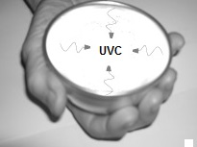
Water Disinfection
Hand-held bowls are provided with nanoscale ZnO coatings to produce UVC from body heat and disinfect drinking water
No electricity – West Africa
LEDs in the UVC are thought to provide the future disinfection of drinking water. But LEDs require electricity and cannot achieve the 100% efficiency of QED disinfection.
Similar to nano-coated Turbine Blades, nano coatings on drinking bowls are likely to rub off in cleaning. Molding 50 nm ZnO NPs dispersed in a 100 micron teflon-composite is suggested.
TBC on Turbine Blades ?

Slide 16
QM in Nanotechnology
Nanoparticle Combustion
Quantum v. Statistical Mechanics

Slide 17
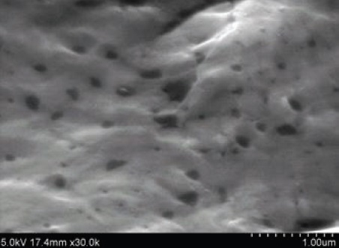
NP Combustion
Add carbon NPs to a molten aluminum in air ( 0xygen ), cool to ambient and take SEM micrographs
Carbon NPs did not combust at 600 C?
C + O² → CO²
Repeat for micron size porous carbon,
Carbon NPs not found in SEM → Complete NP combustion ?
Tensile tests show NPs enhance mechanical properties
Carbon enhances aluminum bond ? DFT disproved
QM Interpretation: NPs do not have heat capacity
Macro carbon increases in temperature. NPs remaining after combustion stay at high temperature and also combust.
Temperature changes do not occur in NPs

Slide 18
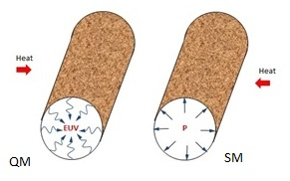
Quantum v. Statistical Mechanics
MD simulations show very high pressures - tens of thousands of atmospheres - are produced in nanotubes even if open at the ends to atmospheric pressure!!!
$$P=kT\left[ρ−\frac{1}{V}ln〈exp\left(−\frac{ΔU}{kT}\right)〉\right]$$
By QM, atoms in nanopores under high EM confinement have vanishing kT heat capacity requiring pressure P to also vanish.
Enhanced chemistry in nanotubes is caused by EUV radiation.

Slide 19
Conclusion
QED is the Fourth mode of heat transfer
But only in nanostructures !!!

Slide 20
Questions & Papers
Email: nanoqed@gmail.com
http://www.nanoqed.org
Notes:
Enter speaker notes here.

