Slide 1
The Fourier Law at Macro and Nanoscales
Thomas Prevenslik
QED Radiations
Discovery Bay, Hong Kong
1
Notes:
Enter speaker notes here.

Slide 2
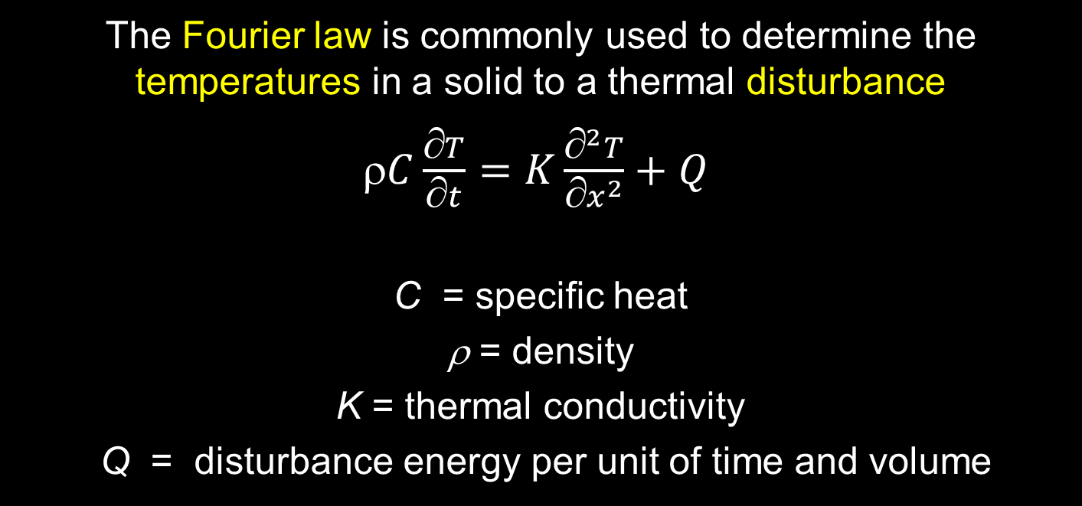
Introduction
The Fourier law is commonly used to determine the temperatures in a solid to a thermal disturbance
$C\frac{∂T}{∂t}=K\frac{∂^{2}T}{{∂x}^{2}}+Q$
C = specific heat
ρ = density
K = thermal conductivity
Q = disturbance energy per unit of time and volume
2

Slide 3
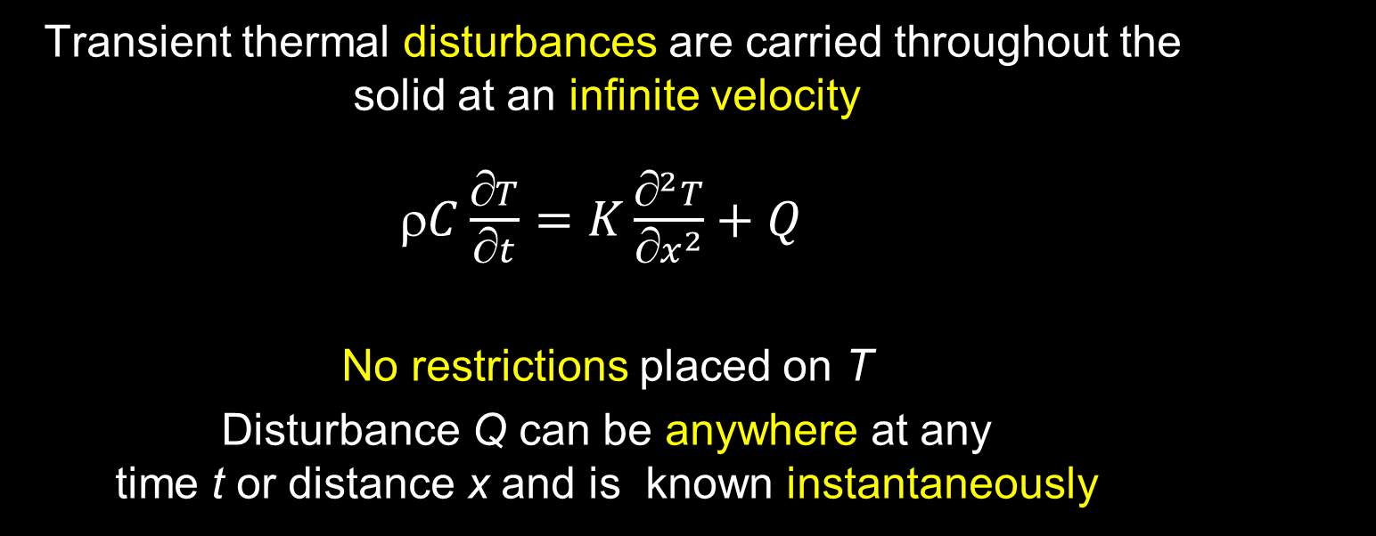
Assumptions
Transient thermal disturbances are carried throughout the solid at an infinite velocity
$C\frac{∂T}{∂t}=K\frac{∂^{2}T}{{∂x}^{2}}+Q$
No restrictions placed on T
Disturbance Q can be anywhere at any time t or distance x and is known instantaneously
3

Slide 4
Problem
Although Fourier’s law has been verified in an uncountable number of heat transfer experiments, the Fourier law itself remains a paradox
Based on theories of Einstein and Debye, the heat carrier in the Fourier law is the phonon with the disturbance moving at acoustic velocities
The Fourier law that assumes the disturbance is instantaneously known everywhere – even at a distant point suggests the disturbance travels at an infinite velocity in violation of the theory of relativity.
4

Slide 5
Modifications
Many proposals of modifying the Fourier law have been made to allow infinite velocity or that disturbances are instantaneously known everywhere
One proposal is the Cattaneo-Vernotte or CV equation that assumes the Fourier law is valid at some time after the disturbance occurs
5

Slide 6
CV Equation
Rewrite Fourier’s law with
α $=\frac{K}{ρC}$
$$C\frac{T}{t}=K\frac{^{2}T}{{x}^{2}}+Q → ∇^{2}T −\frac{1}{α} \frac{T}{t}=−\frac{Q}{K}$$
Suppose the heat flux q appears only in a later instant, t + τ.
q $\left(x,t+ τ\right)=−K\frac{∂T\left(x,t\right)}{∂x}$
Expanding the heat flux q in a Taylor Series around τ = 0 gives,
q $\left(x,t+ τ\right)=q\left(x,t\right)+τ\frac{∂q\left(x,t\right)}{∂x}$
6

Slide 7
CV Equation (cont’d)
$$\frac{∂q\left(x,t\right)}{∂t}+q\left(x,t\right)=−K\frac{∂T\left(x,t\right)}{∂x}$$
$^{2}T −\frac{1}{α} \frac{T}{t}−\frac{1}{u^{2}}\frac{^{2}T}{x^{2}}=−\frac{1}{K} \left(Q+τ\frac{q}{t}\right) , u=\sqrt{ατ}$
CV
$$^{2}T −\frac{1}{α} \frac{∂T}{∂t}=−\frac{Q}{K}$$
Fourier
Instead of the Fourier parabolic equation , the CV equation is hyperbolic giving a wave nature of heat propagation.
However, the Fourier law is simpler.
7

Slide 8
Alternative
What the incredible success of the Fourier law in explaining thermal conduction is telling us is the disturbances are indeed instantaneously known everywhere in the solid.
Instead of modifying the Fourier law by mathematical trickery to avoid infinite velocity, we should be looking for a mechanism that reasonably approximates the assumption that disturbances travel at an infinite velocity.
8

Slide 9
Proposal
BB radiation present in all solids is the mechanism that validates the Fourier law at the macroscale.
Planck’s QM allows BB photons to carry the temperature of the atom in a thermal disturbance at the speed of light throughout the solid approximating the Fourier law that assumes disturbances travel at an infinite velocity.
However, the Fourier law at the nanoscale is not applicable as QM precludes the atom from having the Planck energy for the BB photon to carry through the solid.
9

Slide 10
BB Radiation
The BB radiation spectral energy density U(λ,T)
emitted from the atom at temperature T,
$$U\left(λ,T\right)=\frac{2πhc^{2}}{λ^{5}}\frac{1}{e^{\frac{hc}{λkT}}−1}$$
The BB radiation is observed to move at the speed of light c depending on the temperature T and the EM confinement wavelength λ
10

Slide 11
QM Restrictions
Macroscale kT > 0
kT
QM
kT ≅ 0
Nanoscale kT ≅ 0
BB radiation valid at macroscale, but not at nanoscale
11

Slide 12
TIR Confinement
In 1870, Tyndall showed photons are confined by TIR in the surface of a body if the refractive index of the body is greater than that of the surroundings.
Why relevant? NWs have high surface to volume ratio.
Absorbed EM energy is concentrated almost totally in the NW surface that coincides with the mode of the TIR photon.
Under TIR confinement, QED induces the absorbed EM energy to simultaneously create excitons
f = (c/n)/λ λ = 2D E = hf
12

Slide 13
Simulation
Transient response of a semi-infinite region at temperature T_{o} subject to a sudden surface temperature T_{i}.
$$ = \frac{T−T_{o}}{T_{i}−T_{o}}$$
$$=erf\left(\frac{x}{2\sqrt{αt}}\right)$$
Fourier
$$_{BB}=erf\left(x/2\sqrt{\left(t−\frac{x}{c/n}\right)}\right)$$
BB
13

Slide 14
Simulation
14

Slide 15
Conclusions - Macroscale
The paradox that the Fourier law assumes heat carriers travel at an infinite velocity is resolved by BB photons that carry the Planck energy of the atoms throughout the solid at the speed of light
The BB photons carry Planck energy E = kT at the temperature T of the atoms in the thermal disturbance throughout the solid. The response of the solid still requires solutions of the Fourier equation
There is no need for the CV equation or mathematical trickery to show the validity of the Fourier law
15

Slide 16
Conclusions - Nanoscale
The Fourier law is not applicable because QM precludes the atom from having the Planck energy E = kT to allow being carried by BB photons through the solid.
QM requires the atom under TIR confinement to conserve absorbed EM energy by creating QED induced EM radiation.
QED induces excitons that charge by holons while the paired electrons escape, or the holons upon recombination with electrons emit EM radiation to the surroundings.
QED radiation at the speed of light effectively negates thermal conduction by phonons in the Fourier law .
16

Slide 17
Questions & Papers
Email: nanoqed@gmail.com
http://www.nanoqed.org
17
Notes:
Enter speaker notes here.

