Slide 1
Near-Field Radiation by Quantum Mechanics
Thomas Prevenslik
QED Radiations
Discovery Bay, Hong Kong
1
Notes:
Enter speaker notes here.

Slide 2
Introduction
The Planck theory of BB radiation giving EM radiation with temperature defines the SB radiative heat transfer between hot TH and cold TC surfaces
EM = Electromagnetic
SB = Stefan-Boltzmann
$$Q= σA\left(T_{H}^{4}−T_{C}^{4}\right)$$
Valid if the surfaces are separated by macroscale gaps.
Recently, solutions of Maxwell’s equations show radiative heat transfer for nanoscale gaps is enhanced by 3-4 orders of magnitude above Planck theory
2

Slide 3
Problem
The Maxwell solutions ignore the fact QM denies atoms under the EM confinement in nanoscale gaps to have the heat capacity to fluctuate in temperature as required by the FDT.
QM = quantum mechanics
FDT = fluctuation-dissipation theorem.
3

Slide 4
Planck v. Near-Field
Planck never stated his theory bounded the near-field, but was surely aware contact resistance from close surfaces decreases - not increases heat transfer.
But if so obvious,
How then did the notion originate of increasing heat transfer by nanoscale gaps ?
4

Slide 5
Origin
Near-field heat transfer began almost 50 years ago on the counter-intuitive conjecture that BB heat transfer is greatest at zero surface spacing.
Based on practical grounds it is impossible to bring BB surfaces to zero spacing without making thermal contact, so near-field enhancement cannot be achieved.
But even if the BB surfaces are close but not contacting, QM requires the atoms in the surfaces to have vanishing heat capacity, and therefore temperatures cannot fluctuate as required to satisfy the FDT
5

Slide 6
Purpose
To question the conjecture that near-field heat transfer is enhanced above Planck theory
because
By QM, the Maxwell solutions cannot satisfy the FDT that requires temperatures to fluctuate in nanoscale gaps
and
Propose SB is still valid in near-field
6

Slide 7
Proof SB is valid in Near-field
D
$$Q= σA\left(T_{H}^{4}−T_{C}^{4}\right)$$
$$T_{H}^{}$$
$$T_{C}^{}$$
d_{s} d d_{s}
d < D
D = vacuum d + dead space 2d_{s} .
By QM, dead space lacks heat capacity → No temperature fluctuations
FDT not satisfied adjacent T_{H} and T_{C}
Radiation passes through D without absorption allowing the SB to be valid for all gaps d < D,
D = Smallest gap where SB is valid
7

Slide 8
QM v Classical Physics
Classical Physics
kT 0.0258 eV
20
$$T_{H}^{}$$
QM
$$T_{C}^{}$$
d < 20
At 300K, λ = 40 microns → D = 20 microns
Reduce gap d < 20 microns
What is QSB for d < 20 microns?
Same as for d = 20 microns.
SB is valid for all d < 20 microns
8

Slide 9
Maxwell Solutions
Solution of Maxwell’s equations by evanescent waves
$$Q\sim \frac{1}{π^{2}d^{2}}\frac{Im\left(ε_{H}\right)Im\left(ε_{C}\right)}{{\left|\left(ε_{H}+1\right)\left(ε_{C}+1\right)\right|}^{2}}\left[Θ\left(ω,T_{H}\right)−Θ\left(ω,T_{C}\right)\right]$$
Θ(ω, T) = frequency form of Einstein-Hopf evaluated for evanescent waves in the NIR where the atom has heat capacity
Maxwell solutions exclude Θ(ω, T) under EM confinement of the penetration depth of the evanescent wave at UV frequencies where the heat capacity vanishes
9

Slide 10
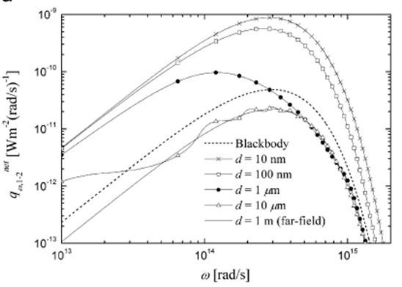
Maxwell Solutions
$$E=\frac{\frac{hc}{λ}}{exp\left(\frac{hc}{ λkT}\right)−1}$$
ω = 3x10¹⁴ rad/s
f = 4.8x10¹³ /s
NIR λ = 6.3 microns
T = 800 K
Θ(ω,T) = 0.012 eV
d = 100 nm
UV λ = 200 nm
ω = 15x10¹⁵ rad/s
Θ(ω,T) = 5x10⁻³⁹ eV
FDT not satisfied
Maxwell Solutions
Evanescent Waves - TH = 800 K , TC = 200 K
10

Slide 11
SB and Maxwell
In near-field, QM invalidates FDT
Maxwell solutions of evanescent tunneling are questionable
Validity of SB in Near-Field?
QED Tunneling
11

Slide 12
QED Tunneling
QED induces excluded radiation to create photons that tunnel across the gap and allow the SB to remain valid
QED
$QQED=$ q NP
$$q =\frac{hc}{2d}$$
QED Photon
SB
$$QSB= σA\left({TH}^{4}− {TC}^{4}\right)$$
Valid SB in Near-Field requires:
$$N_{p}= \frac{Q_{SB}}{q}=\frac{2σdA\left(T_{H}^{4}−T_{C}^{4}\right) }{hc}$$
Number of QED Photons
12

Slide 13
Summary
QSB is constant for all d
Heat transfer by Maxwell exceeds SB by 3-4 orders
QQED = QSB for all d, but E and NP of QED photons vary
QED does not increase heat transfer above SB
13

Slide 14
Conclusions
QED and SB is simple compared to computationally intensive Maxwell solutions
QED conserves excluded SB radiation by creating standing wave photons that tunnel SB radiation across the gap.
QED supersedes evanescent wave tunneling
Planck’s limit on far field radiative heat transfer is not exceeded in the near field.
QM negates the classical physics assumption in Maxwell solutions that atoms in nanoscale gaps satisfy the FDT
14

Slide 15
Questions & Papers
Email: nanoqed@gmail.com
http://www.nanoqed.org
(Paper on Home Page)
15
Notes:
Enter speaker notes here.

