Slide 1
ATP Synthesis by Endogenous UV Radiation
Thomas Prevenslik
QED Radiations
Berlin, Germany
Notes:
Enter speaker notes here.

Slide 2
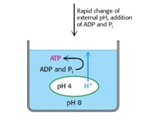
Introduction
In the 1960‘s, Mitchell proposed mitochondria synthesis of ATP followed the theory of chemiosmosis based on a H+ gradient across the inner membrane
Chemiosmosis supported by acid-bath experiment
Grana of chloroplasts acidified in pH 4 bath exposed to an alkaline pH 8 bath, ATP measured → H+ gradient produced ATP.

Slide 3
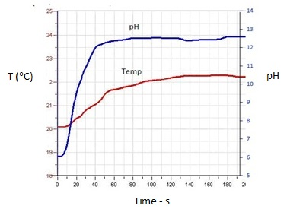
Problem
Acid-bath also increased bath temperature from heat of titration

Slide 4
Heat and ATP?
In classical physics, heat increases temperature
But in quantum mechanics, the Planck law denies heat increasing in temperature at the nanoscale.
How does conservation proceed?
Propose: Heat creates EM radiation
If so,
Did EM radiation produce ATP in acid-bath experiment?

Slide 5
EM radiation in Evolution
On primitive Earth, solar UV exceeded all energy sources
Did UV create ATP ?
ATP synthesis by UV confirmed* from adenine, ribose, and phosphorus
*Sagan et al. Nature, 199, 222 (1963)
Today, solar UVC is not available
How do mitochondria now produce UVC ?

Slide 6
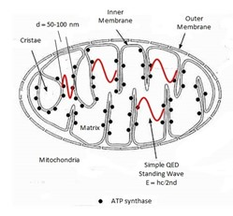
Proposal
Heat Q induces nanoscale mitochondrial cristae geometry to produce UVC standing waves
Heat Q
Theory: Simple QED

Slide 7
Simple QED
Heat → Nanoscale → EM radiation
Nanoparticle – diameter d < 100 nm
d
Simple QED
Radiation
E = hc / 2nd
n = Refractive index
Heat
Q
λ/2
Q → NP
Surface Heat
EUV Fluorescence
UV
ROS
VIS Plasmon Resonances
No
Temperature
Change
EM confinement
λ/2 = d

Slide 8
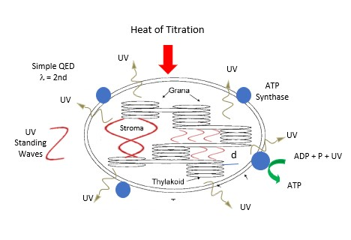
Chloroplast - Grana

Slide 9
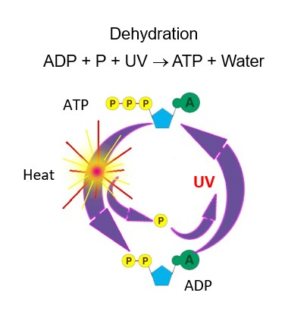
ATP Synthesis by UV
UV damages DNA but repaired.
UV supports ATP synthesis.
UV scrambling of DNA explains
Darwin’s origin of species
Phosphate bond P = 0.304 eV
1 UVC photon at 4.88 eV converts ∼ 16 ATP

Slide 10
Conclusions
UV by simple QED from titration heat created the ATP in the acid-bath experiment
ATP by endogenous UV is direct and far simpler than complex enzyme dependent chemiosmosis

Slide 11
Reference & Contact
Homepage: nanoqed.org – 2019
10 th Anniversary Target Mitochondria
Paper: “ATP by endogenous UV Radiation”
Email: nanoqed@gmail.com
Notes:
Enter speaker notes here.

