Slide 1
The Causal Link between Nano –Toxicology and Human Health: DNA Damage by UV Emission from Nanoparticles
Thomas Prevenslik
QED Radiations
Hong Kong and Berlin
1
Notes:
Enter speaker notes here.

Slide 2
Introduction
We know solar UV radiation damages the DNA to cause skin cancer
Since solar UV does not penetrate the skin, we think cancer of internal organs by UV cannot occur
However,
If UV is somehow created inside the human body, the DNA damage could cause cancer of internal organs
Does a causal link to UV exist?
2

Slide 3
Proposal
NPs provide the source of UV radiation inside the body
NPs = Nanoparticles
NPs are ubiquitous entering the body in the air we breathe and the food we eat
Pathway of DNA damage by NPs is known to mimic that by conventional UV sources
Therefore
The causal link between NPs and cancer is proposed to be the DNA damage by UV radiation from NPs
3

Slide 4
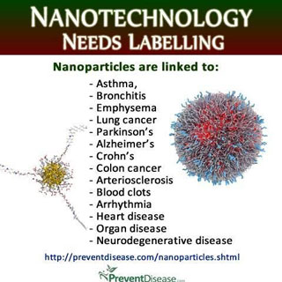
Nanotechnology
Are NPs a health problem?
Experiments over the past decade show NPs damage DNA
Protection of consumer health by labeling of products having NPs
Diversity of human health problems suggests DNA scrambled – no single pathogen
4

Slide 5
DNA Damage
DNA damage by NPs is not new.
In 2003, NPs were shown to induce oxidative stress and inflammation, but the mechanism was not understood although correlated with large S/V ratios. S/V = surface-to-volume.
In 2008, DNA damage was linked to cancer by ROS
ROS = reactive oxygen species, e.g., OH* radicals
But to create the OH*, NPs must produce at least 5 eV
How do NPs create EM radiation > 5 eV ?
No basis - just assumed !!!
5

Slide 6
Chemical DNA Damage
Currently, NPs are thought to damage DNA by ROS driven by chemical reaction of the NP material in contact with the DNA
But
DNA is damaged with chemically inert quartz NPs
and
DNA damage at a distance across cell membranes
Chemical reaction of NPs with DNA unlikely !!!
6

Slide 7
Quantum Mechanics
By classical physics, GM food under metabolic processes in the gut is thought to increase the NP temperature.
GM = Genetically Modified
But QM governs the nanoscale.
QM stands for quantum mechanics
By QM, the heat capacity of NPs vanishes. Conservation of heat in NPs cannot occur by an increase in temperature and instead proceeds by emission of UV radiation.
UV radiation > 5 eV creates the ROS
No need for ROS, just need UV radiation
7

Slide 8
QM - Planck law
Classical physics (kT > 0)
kT 0.0258 eV
QM
(kT < 0)
NPs
How do NPs provide high EM confinement?
Under EM confinement at λ < 100 nm, QM requires atoms in NPs to have vanishing heat capacity
High S/V ratios → atoms confined over NP dimensions
8

Slide 9
Simple QED
In NPs, simple QED converts heat Q into EM radiation because QM precludes conservation by temperature.
QED is a simple form of the complex light and matter interaction advanced by Feynman and others
Heat → NP w/o heat capacity → EM radiation
f = (c/n)/λ λ / 2 = d E = h f N = Q / E
QED
Radiation
λ/2 = d
Heat
Q
λ/2
High S/V ratios
No
Temperature
Change
9

Slide 10
EM Emission
λ = 2 nd
NPs < 80 nm Talc
254 nm UV-C damages DNA
Alternatives to produce UV in NPs?
10

Slide 11
Multi-IR Processes
UCNPs utilize 2 or more low-energy excitation IR photons at 1000 nm to create UV at 350 nm.
UCNPs = Upconversion nanoparticles
UV by UCNPs is highly speculative
Simple QED does not rely on UV produced by speculative multi - IR photon processes as the NP is directly excited, i.e., E = hc/2nd > EUV
Lower NP states excited by EUV fluorescence, e.g., plasmon resonances
Chen, G., et al., “Upconversion Nanoparticles: Design, Nanochemistry, and Applications in Theranostics,” Chemical Review, 114, 5161–5214, 2014.
11

Slide 12
Discussions
J&J Lawsuit
NPs in GM food
Politics
FDA and Monsanto
March against Monsanto
Nobel Laureates v. Greenpeace
Milan Science Museum
Disinfectant Flashlight
12

Slide 13
J&J Lawsuit
In May 2017, J&J paid more than $110 m to a woman who says she developed ovarian cancer using its talcum powder.
In 2015, J&J lost 3 cases related to its talc-based products, but won its first trial in March, 2017
The ACS position on talcum powder and cancer depends on whether the talc is asbestos-free.
Natural talc contains asbestos and does cause cancer, but asbestos-free talc is used in baby powder since the 1970s
Scientific evidence about asbestos-free talc is less clear.
http://www.bbc.com/news/world-us-canada-39816799
13

Slide 14
Toxicity of Talc
Genotoxicity tests do not control particle size as NPs < 100 nm are required to produce UV
Usually tests for talc > 1 micron → EM radiation λ > 2(1.59)1 = 3.2 micron → IR and does not damage DNA
Need to measure NPs in talc < 80 nm !!!
Safety Assessment of Talc as Used in Cosmetics,
1101 17th Street, NW, Suite 412 ♢ Washington, DC 20036-4702
14

Slide 15
NPs in GM Food
Herbicide-resistant weeds now plague more than 60 million acres of US farmland.
To control weeds, the non-selective herbicide glyphosate a that kills most plants is widely sprayed on fields.
But it is not possible to only spray weeds without spraying soy and corn crops. Glyphosate is therefore GM to kill only weeds while at the same time enhancing the growth of soy and corn crops. GM stands for genetically modified. However, glyphosate does not readily penetrate the leaves of weeds and crops, and therefore is mixed with adjuvants that aid leaf penetration. For decades, NPs and specifically CNTs that readily penetrate leaves have been used as adjuvants allowing glyphosate to be carried to plant roots for more efficient absorption. NPs stand for nanoparticles and CNTs for carbon nanotubes.NPs offer significant technological advancements as antibacterial agents in food processing, reducing infections in burn treatment, sunscreen skin lotions, and treating cancer tumors.
However, NPs have a darkside
GM food offers the advantage of enhanced growth to feed the world’s population
But GM foods are controversial !!!
15

Slide 16
Pros and Cons
Donald Huber, the prominent critic of GM foods claims a pathogen is produced that harms human health, e.g., residents living close to sprayed GM soybean fields in Argentina developed cancers and birth defects.
However, GM food corporations argue science is still looking for, but not found Huber’s pathogen to establish the causal link between GM food and human health problems.
See Pros and Cons in:
https://www.geneticliteracyproject/gip-facts/don-huber-science-still-looking-for-purdue-professors-gmo-pathogen-time-bomb/
16

Slide 17
GM Food
In US farmland, herbicide-resistant weeds now plague more than 60 million acres.
To control weeds, Monsanto’s Roundup containing
the herbicide glyphosate is widely sprayed on fields.
Glyphosate does not readily penetrate the leaves of weeds and is mixed with POEA that aids penetration.
POEA = polyoxyethyleneamine
Weeds alone cannot be sprayed and the POEA enters the leaves of contiguous corn and soybean crops as an emulsion of NP globules that finally reside in the plant crop.
17

Slide 18
POEA Globule
UV
UV
Cell
Heat
POEA
Globule
Ionize
UV
UV
DNA
Glyphosate
POEA is genotoxic – not glyphosate
18

Slide 19
FDA and US Politics
In 2010, Obama appointed Michael Taylor, former Monsanto vice president as the FDA commissioner for foods.
Before leaving office In 2016, Obama signed Monsanto’s Protection Act into law →
The law states that even if future research shows GM food cause significant health problems, cancer, etc, the federal courts have no power to stop their spread, use, or sales.
In 2017, Obama received USD 400,000 for a Wall Street speech that Big-Money Special Interests are OK???
19

Slide 20
March against Monsanto
On 21 May, 2017, activists marched in Basel, Toronto, Lyon, Marseille, Orlando,… against Monsanto.
The activist claimed:
Research has shown that Monsanto’s GM foods can lead to serious health conditions such as the development of cancer tumors, infertility and birth defects
Monsanto counter claim:
There’s no scientific proof of its main ingredient glyphosate being the cause of cancer.
Consistent with simple QED, but POEA not mentioned
20

Slide 21
Nobel Laureates and Greenpeace
Over 100 Nobel Laureates signed a letter asking Greenpeace to halt its campaign against GM crops demanding:
“Abandon your campaign against GMOs”
The Laureates argued that GMOs can offer food sources to the world’s poorest concluding :
How many people in the world must die before we consider this Greenpeace action a
A crime against humanity?
21

Slide 22
Arguments
Scientific
Linking GM food to human health requires a causal relation, e.g., DNA damage from UV produced from NPs of POEA globules heated in the gut.
Legal
Even if the Laureates did not know UV is produced in POEA globules, they knew or should have known experiments have shown NPs damage the DNA of living cells.
22

Slide 23
Crimes Against Humanity
Prior knowledge is the legal basis of a crime against humanity.
But it is unlikely the Laureates knew that POEA globules in Glyphosate produce low-level UV
Experimental data in support of genotoxicity from POEA is required before GM food is judged a crime against humanity.
Therefore
The Nobel Laureates should retract their signatures pending experimental data showing GM food is not genotoxic
23

Slide 24
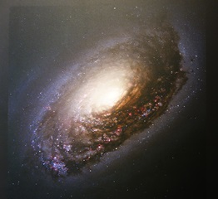
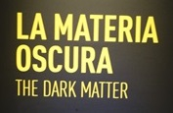
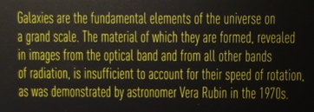
Milan Science Museum
Light absorbed by cosmic dust is redshift giving the impression velocities are higher than that necessary to hold the galaxy together → dark matter ?
24

Slide 25
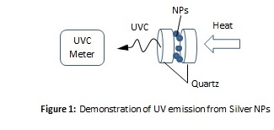
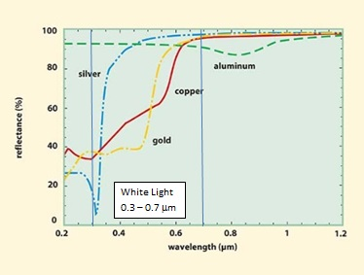
Disinfectant Flashlight
Cost of white light LED flashlight ∼ $10
Cost UV (365 nm) flashlight ∼ $200
Cost UVC (254 nm) flashlight ∼ $1000
Nanocoat the front lens of white light LED flashlight
Similarly, the disinfectant flashlight allows convenient disinfection of hospital rooms
In my abstract, I show an example of simple QED converting heat to UV using silver NPs
Gold coated → λ = 2 (1.4)90 ∼ 254 nm
Needs more work !!!
25

Slide 26
Conclusions
NPs are now common in all foods, GM or otherwise.
Whether NPs are genotoxic requires an extensive and meaningful test program of Monsanto’s Roundup targeting NPs of POEA, but US politics suggests this is not likely.
Nevertheless, NPs by emitting EM radiation beyond the UV damage the human DNA that depending on the individual’s immune system may lead to diverse health problems.
Trump should repeal Obama’s Protection Act leaving Monsanto to defend litigation like J&J.
In the US, politics controls science → perhaps not in the EU?
26

Slide 27
Questions & Papers
Email: nanoqed@gmail.com
http://www.nanoqed.org
27
Notes:
Enter speaker notes here.

