Slide 1
MD by Quantum Mechanics
Thomas Prevenslik
QED Radiations
Discovery Bay, Hong Kong
1
Notes:
Enter speaker notes here.

Slide 2
Introduction
Traditionally, MD simulations of chemical reactions are thought mediated by changes in the positions of reactant atoms by temperature induced molecular vibrations based on the equipartition theorem.
MD = molecular dynamics.
2

Slide 3
Classical Physics
MD assumes classical physics
MD simulations of the bulk performed under PBC assume atoms have heat capacity
PBC = periodic boundary conditions
In the macroscopic bulk, all atoms do have heat capacity
Traditional MD programs, e.g., A&T, are valid for bulk PBC simulations
A&T = Allen & Tildesley
3

Slide 4

Equipartition Theorem
MD assumes the temperature T of the atoms is given by the average kinetic energy <KE> of an ensemble of N atoms by the equipartition theorem of statistical mechanics,
$$T=2<KE>/3N$$
4

Slide 5
Validity
There are questions as to the validity of MD simulations
A fundamental question is whether MD based PBC and the equipartition theorem can be extended to discrete molecules where local temperatures are forbidden by the Planck law of QM that requires atoms have vanishing heat capacity
QM = quantum mechanics
5

Slide 6
Planck law
Classical physics (kT > 0)
kT 0.0258 eV
QM
(kT < 0)
Molecules
Under EM confinement at λ < 0.1 microns, QM requires atoms in molecules to have vanishing heat capacity
6

Slide 7
Problem
The fact discrete molecules are precluded by QM from fluctuating in temperature contrary to the equipartition theorem, so
How do molecules vibrate?
There is no question temperature is somehow connected to molecular vibration, but a physical mechanism is required which cannot be the traditional
esoteric equipartition theorem.
7

Slide 8
Background
Recently, RIXS was shown [1] to provide vibrational control in photochemical reactions.
RIXS = resonant inelastic X-ray scattering spectroscopy
RIXS shows X-rays may impulsively alter atom positions selectively by momentum tuned to stretching while another tuning excites bending modes
Atoms are positioned without temperature !!!
[1] R. C. Couto, et al., “Selective gating to vibrational modes through resonant X-ray scattering,” Nature Communications, 8, 14165, 2017.
8

Slide 9
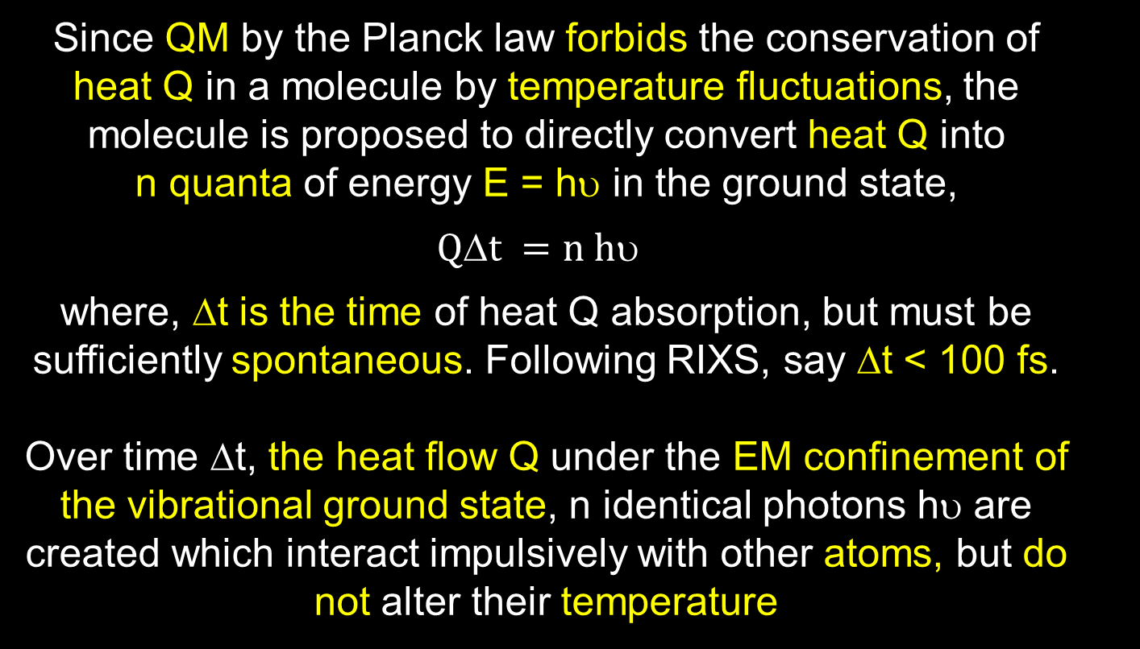
Proposal
Since QM by the Planck law forbids the conservation of heat Q in a molecule by temperature fluctuations, the molecule is proposed to directly convert heat Q into n quanta of energy E = hυ in the ground state,
$$Qt =n h$$
where, Δt is the time of heat Q absorption, but must be sufficiently spontaneous. Following RIXS, say Δt < 100 fs.
Over time Δt, the heat flow Q under the EM confinement of the vibrational ground state, n identical photons hυ are created which interact impulsively with other atoms, but do not alter their temperature
9

Slide 10
MD Solution
Nitrogen molecule in stretch mode
Model
Heat Flow
Impulse Force
Results
12

Slide 11

Model
Nitrogen in the stretch mode
Modeled by bead-spring with force F,
$F=K_{s}\left(x −d/2\right)$ ,where d is the bond length
Experimental resonance, 2331 /cm ∼ ${7x10}^{13}$ Hz
Anti-node
11

Slide 12
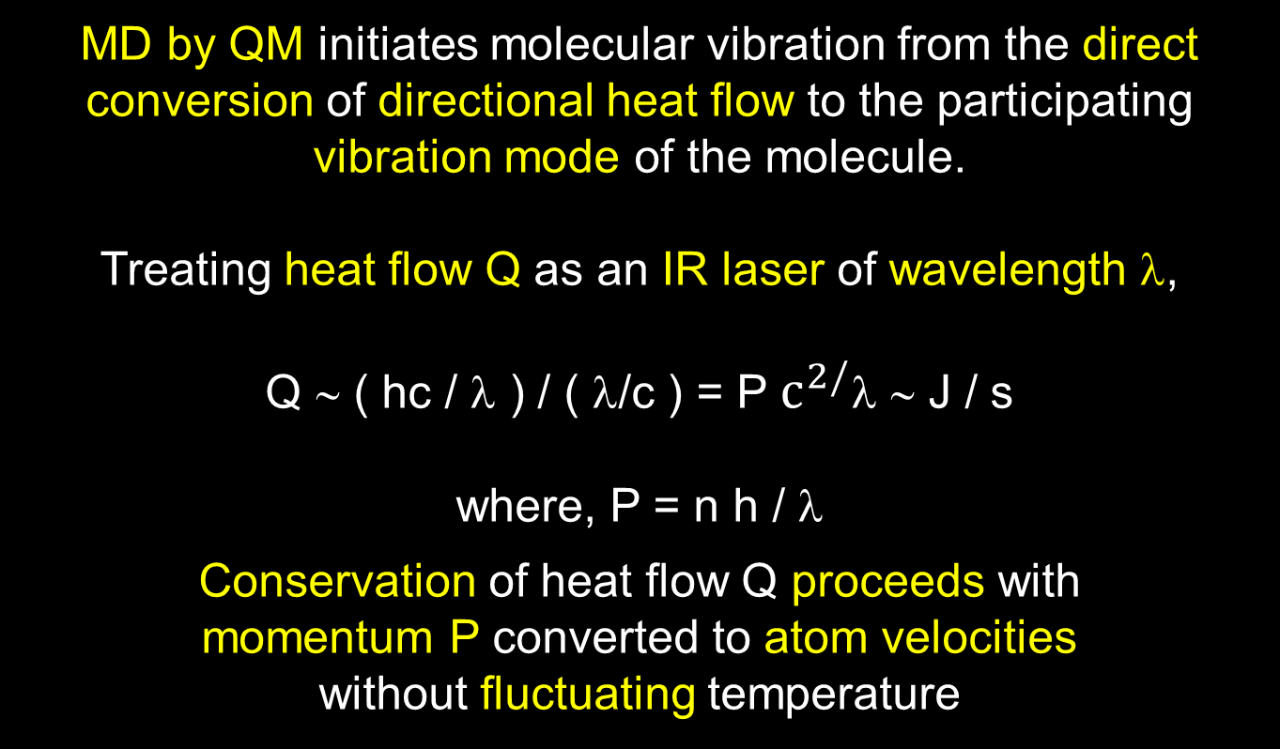
Heat Flow
MD by QM initiates molecular vibration from the direct conversion of directional heat flow to the participating vibration mode of the molecule.
Treating heat flow Q as an IR laser of wavelength λ,
Q ∼ ( hc / λ ) / ( λ/c ) = P $c^{2/}$λ ∼ J / s
where, P = n h / λ
Conservation of heat flow Q proceeds with momentum P converted to atom velocities
without fluctuating temperature
12

Slide 13


Impulse Forces
The impulse force F applied to an atom of mass m depends on the directionality of heat flow Q
and time Δt
Heat Flow Q
m
F
V
Momentum
P = F Δt = $mV$
Impulse Force
$$F=P/t$$
13

Slide 14
Results
The fundamental quantum E = hυ is assumed filled with the equivalent of n = 100000 IR photons. For Q = 320 mW, τ = n hυ/Q =14.5 fs << 100 fs
MD by QM shows V = 660 m/s and X = 50±1.5 pm
14

Slide 15
Conclusions
  MD by QM supersedes traditional MD simulations of RIXS experiments under synchrotron radiation by avoiding the erroneous temperature changes in X-ray heating predicted by the equipartition theorem of classical physics.
Ordinary chemical reactions may be initiated by the QM induced conversion of directional heat flux Q in to molecular vibration.
IR lasers and not synchrotrons are suggested for the practical control of atoms by heat flow Q in chemical reactions.
15

Slide 16
Questions & Papers
Email: nanoqed@gmail.com
http://www.nanoqed.org
16
Notes:
Enter speaker notes here.

