Slide 1
Dark matter does not exist
⟨
If redshifts of galaxy velocities are corrected for cosmic dust
⟨
Thomas Prevenslik
QED Radiations
Hong Kong and Berlin
1
Notes:
Enter speaker notes here.

Slide 2
Preface
Nanoscience as the science of the very small and the search for dark matter in the Universe may appear to be unrelated, but find commonality in NPs
NPs = nanoparticles
In nanoscience, NPs are thought to conserve heat by increasing in temperature
But the Planck law of QM requires the heat capacity of the quantum sized NPs to vanish → no temperature increase
QM = quantum mechanics
2

Slide 3
History
In 1926, Hubble discovered the Universe was expanding based on velocity measurements inferred from Doppler redshifts of light from recessing galaxies.
But cosmic dust NPs permeate the Universe.
As the galaxy light travels to the Earth it interacts with cosmic dust matter
Astronomers assumed the light-matter interaction followed classical physics that today has led to dark matter
But if QM is assumed, no dark matter
3

Slide 4
Introduction
Dark matter has a long history
In the 1930’s,
The Milky Way was found to rotate faster than expected suggesting dark matter was present to explain spiral shape, and
To keep the Coma cluster of galaxies together, the mass of dark matter would have to be much higher than visible matter
Similar to Hubble, early velocity measurements of galaxies were based on redshift of optical wavelengths
4
Since 1950, the computation of rotation curves became vogue after the radio astronomy discovery [4] of the 21 cm line of neutral hydrogen atoms. Unlike optical redshifts based on emission wavelengths, radio redshifts are determined from the frequencies of thermal emission.
In the 1970’s, rotation curves based on both optical and radio redshifts were resolved [5] for the M31 spiral galaxy by assuming the presence of invisible mass thereby marking the beginning of the modern search for dark matter.
Today, scientists generally agree that dark matter is invisible having about 5-times the mass of ordinary matter, but what it is and how it was formed has remained a mystery. Many dark matter dark matter theories are proposed. dark matter may not exist.

Slide 5
Introduction (cont’d)
In 1950, the radio astronomy discovery of the 21 cm line of neutral hydrogen atoms based on temperature fluctuations supported dark matter
In the 1970’s, Vera Rubin confirmed dark matter for the M31 spiral galaxy
Scientists generally agree that dark matter is invisible having about 5-times the mass of ordinary matter, but what it is and how it was formed has remained a mystery.
5

Slide 6
QM v. Classical Physics
Classical physics allows quantum sized dust NPs and neutral hydrogen atoms to fluctuate in temperature
QM forbids temperature fluctuations as atom heat capacities vanish → conservation of galaxy photons by non-thermal mechanisms →
NPs: The galaxy photon is conserved by redshifted optical emission,
Hydrogen atoms: The galaxy photon is conserved by optical emission of the 21 cm line.
QM requires optical telescopes and rejects radio telescopes using temperature fluctuations for 21 cm line
6

Slide 7
Proposal
Dark matter is not a physical property of the Universe that can be discovered by experiment and only exists because optical redshifts were not corrected for cosmic dust.
Radio redshifts of the 21 cm line based on fluctuating temperatures have no meaning by QM are excluded from this talk
7

Slide 8
Optical Redshift
Measured redshift
$$Z_{meas}=\frac{Δ}{}=\frac{\left({Δ}_{V}+{Δ}_{D}\right)}{}$$
Δλ_{V} = wavelength increment of galaxy recession
Δλ_{D} = wavelength increment of cosmic dust
Z_{V} = Δλ_{V}/λ recession redshift
Z_{D} = Δλ_{D}/λ cosmic dust redshift
$$Z_{meas}=Z_{V}+Z_{D}$$
8

Slide 9
Heat Capacity
$$E=\frac{\frac{hc}{λ}}{exp\left(\frac{hc}{λkT}\right) −1}$$
NPs
Classical physics (dotted lines) allows NP atoms for any EM confinement to always have kT heat capacity.
QM requires heat capacity of NPs < kT at high EM confinement.
How do NPs provide EM confinement < 0.1 microns?
9

Slide 10
EM Confinement
EM confinement of atoms in cosmic dust is a natural consequence of high S/V ratios of NPs
S/V = surface-to-volume
Almost all of the galaxy photon energy is therefore deposited in the NP surface
NP atoms are momentarily placed under EM confinement.
Since the NPs are submicron, the EM confinement is also submicron and the heat capacity vanishes.
10

Slide 11
Simple QED
Simple QED proposed to conserve the heat from absorbed galaxy light under EM confinement is far simpler
Briefly stated:
Under the QM restriction that the heat capacity of the atom vanishes, the heat of galaxy light absorbed in the NP surface creates standing EM radiation having half wavelength λ/2 = d, where d is the NP diameter
11

Slide 12
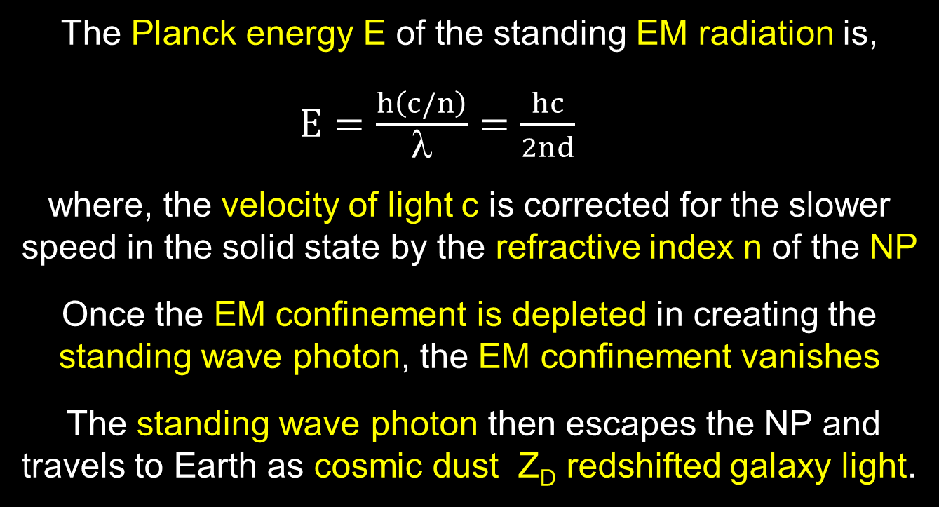
Simple QED(Cont’d)
The Planck energy E of the standing EM radiation is,
$E=\frac{h\left(c/n\right)}{λ}=\frac{hc}{2nd}$
where, the velocity of light c is corrected for the slower speed in the solid state by the refractive index n of the NP
Once the EM confinement is depleted in creating the standing wave photon, the EM confinement vanishes
The standing wave photon then escapes the NP and travels to Earth as cosmic dust Z_{D} redshifted galaxy light.
12

Slide 13
Corrected Redshift
Ly-α
λ = 0.1217 micron
$$Z_{D}=\frac{\left(2nd−λ\right)}{λ}$$
H-α
λ = 0.656 micron
$Hubble:$ $ZL_{y}=ZH_{}$
$$Z_{corrected}=Z_{meas}−\left(ZL_{yα}−ZH_{α}\right)$$
13

Slide 14

Summary
In Cosmic Dust, simple QED redshifts the galaxy photon because QM precludes conservation by temperature.
Galaxy Photon → NP w/o heat capacity → Redshift Photon
f = (c/n)/λ λ / 2 = d E = h f
Galaxy Photon
(λ)
Redshift
Photon
(2nd)
λ/2
High S/V ratios
$$Z_{D}=\frac{\left(2nd−λ\right)}{λ}$$
No
Temperature
Change
14

Slide 15
Discussions
Dark Matter
Accelerating Universe Expansion
Many others – see Paper on Web
15

Slide 16
Dark Matter
In an edge-on view, the spiral galaxy M31 was thought to have a flat velocity profile while Newtonian mechanics suggests decreasing velocity with radius.
The dust redshift Z_{D} is uniform along the radius because the galaxy illuminates about the same amount of cosmic dust NPs along the line-of-sight to the Earth
But the velocities inferred from dust redshift Z_{D} dwarf recession Z_{V} redshifts, Z_{D} > Z_{V} giving the flat profile
Newtonian mechanics is valid if dust corrections are made
Z_{D}
Z_{V}
Z_{D} >
Z_{V}
16

Slide 17
Accelerated Expansion
In 2001, SN was found brighter than it should gave been → accelerated Universe expansion.
Redshift Z_{D} > 0 means the SN appears further away, Z_{meas} = Z_{V} + Z_{D}, but is brighter because the SN is actually at Z_{meas} = Z_{V}
Accelerating Universe is not physical, but rather an anomaly of redshift in cosmic dust.
Z_{V}
Z_{D}
17

Slide 18
Conclusions
Cosmology by cosmic dust is not ground breaking theoretical work, but rather based on the long-forgotten Planck law of QM formulated over a century ago.
Simple QED may initiate a simpler cosmology to explain astronomical observations.
By refuting current theories for dark matter and Universe expansion, perhaps cosmology may return to Einstein’s once upon a time static and dynamic Universe.
18

Slide 19
Questions & Papers
Email: nanoqed@gmail.com
http://www.nanoqed.org
19
Notes:
Enter speaker notes here.

