Slide 1
Molecular Dynamics by X-Rays?
Thomas Prevenslik
QED Radiations
Discovery Bay, Hong Kong
1
Notes:
Enter speaker notes here.

Slide 2
Introduction
Chemical reactions are strongly affected by positions of the atoms produced in vibrations
Recently, RIXS was shown [1] to provide vibrational control in photochemical reactions.
RIXS = resonant inelastic X-ray scattering spectroscopy
RIXS shows X-rays may be tuned to stretching while another tuning excites bending modes
[1] R. C. Couto, et al., “Selective gating to vibrational modes through resonant X-ray scattering,” Nature Communications, 8, 14165, 2017.
2

Slide 3
Theme
RIXS shows X-ray pulse interaction with molecules provides control of vibration modes of atoms,
but
RIXS also provides the experimental basis for the question:
Are X-rays naturally created in atoms controlling ordinary chemical atoms?
3

Slide 4
Proposal
X-rays are created in ordinary chemical reactions using heat from the thermal surroundings by simple QED
And assumes QM governs atomic heating and not classical physics.
QM stands for quantum mechanics.
By QM, heating an atom does not increase temperature as the EM confinement of its high surface-to-volume ratio requires the atom heat capacity to vanish.
Consider the Planck law at 300 K
4

Slide 5
Heat Capacity of the Atom
Classical physics (kT > 0)
kT 0.0258 eV
QM
(kT < 0)
Molecules
Under EM confinement at λ < 0.1 microns, QM requires atoms in molecules to have vanishing heat capacity
5

Slide 6
MD by Classical Physics
By the Planck law, MD simulations of the bulk are performed under periodic boundary conditions (PBC) assume atoms have heat capacity for λ > 100 microns
In the macroscopic bulk by PBC, all atoms do indeed have heat capacity
MD programs, e.g., A&T, are valid for bulk PBC simulations, but invalid for discrete molecules as heat capacity vanishes for λ < 0.1 microns
A&T = Allen & Tildesley
6

Slide 7
Validity of the Equipartition Theorem
Based on statistical mechanics, MD assumes heating a molecule increases the thermal energy of constituent atoms that is converted to kinetic energy by the equipartition theorem → the vibrational motion of atoms.
By QM, the equipartition theorem for molecules having kinetic energy < KE > = 3 N kT / 2 is invalid
as the temperature T of constituent atoms cannot change.
7

Slide 8
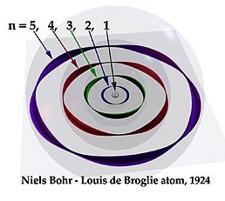
Standing Core Electrons
Simple QED is applied to an atom by
standing waves of core electrons in a circular ring [2]
The standing electron waves consist of n wavelengths λ around the circumference of a ring or radius R,
nλ = 2 π R, n = 1,2,3,...
[2] D. Bergman, Electron Wave Function - Electromagnetic Waves Emitted by Ring Electrons, Foundations of Science, 2005
8

Slide 9
X-rays from Atoms
Since QM precludes atoms from temperature changes, heat flow Q into the atom is conserved by increasing core electron energy levels until X-ray emission.
The heat Q into an atom as a spherical cavity of electron radius R in a thermal bath at absolute temperature To is,
$Q=4R^{2}{(KT}_{o}/R$) = 4π K R To ∼ J/s
The time τ to create a single X-ray photon is,
= E / Q ∼ s
For a bath of water at 310 K typical of atoms in the human body at 40 C, the conductivity K = 0.61 W/m-K →
9

Slide 10
X-rays and Ring Radius
Nitrogen
0.434 keV
R = 469 pm
τ = 62 ps
10

Slide 11
Nitrogen MD Model
Nitrogen in the stretch mode
Modeled by bead-spring with force F,
$F=K_{s}\left(x −d/2\right)$ ,where d is the bond length
Experimental resonance, 2331 /cm ∼ ${7x10}^{13}$ Hz
QM precludes atoms from temperature changes, heat flow Q into the atom is conserved by stretch vibrations by specifying velocity or momenta of atoms
Anti-node
11

Slide 12
MD Solutions
1. Inelastic energy
2. Equipartition Theorem
3. Momenta
12

Slide 13
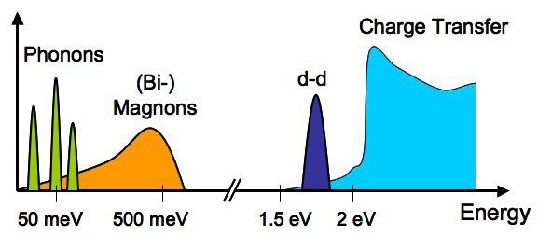
1. Inelastic Energy
Only a fraction η of the K-edge energy E is inelastic
Eo = η E, but η is not known
Vibrations are inelastically excited at Eo < 50 meV
Assuming Eo = 10 meV, V = 371 m/s
The momentum P imparted to the atom is,
$P=\sqrt{2mE_{o} }$ = mV
Perform MD specifying initial velocity V $=\sqrt{2E_{o}/m }$
13

Slide 14
1. Inelastic Energy
Amplitude - X - pm
X = +/- 1 pm
Solutions are correct
V = +/- 371 m/s
Velocity - V - m/s
14

Slide 15
2. Equipartition
One MD method of fixing the kinetic temperarure is to slowly rescale the velociites at ech step by
Factor = ${\left(\frac{T}{F}\right)}^{1/2}$
T = desired temperature F = current temperature
Equipartition → F = 2 <KE> / 3 kN
V new = Vold * Factor
For fast transients like the nitogen stretch mode, the equipartition theorem gives incorrect results.
15

Slide 16
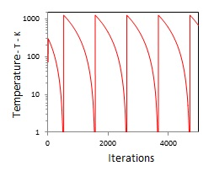
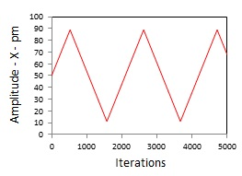
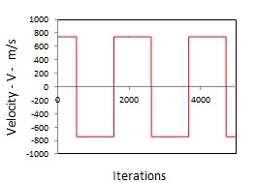
2. Equipartition
The scaling of velocities in the Nitrogen stretch mode was made by constraining the temperature to 310 K,
Temperatures +/- 500 K (310 K)
Amplitude +/- 40 pm ( 1 pm)
Velocites +/- 740 m/s (371 m/s)
Solutions are incorrect
16

Slide 17
3. Momentum
The X-ray photon has momentum P depending on x, y positions, P = h / λ. The force F on the atom,
$F t=m V=P$
The force F is, F = P / Δt.
And is updated every iteration time step Δt
17

Slide 18
3. Momentum
X =+/- 0.6 pm
Solutions are correct
V =+/- 230 m/s
18

Slide 19
Summary
Atoms in a nitrogen molecule continually absorb heat Q from the surroundings and X-rays from other atoms
By QM, heat Q into the atom may only be conserved by increasing the core electron energy to E = 0.434 keV
Over time < 70 ps, heat Q accumulates until core electron energy reaches the K-edge inducing X-ray emission that excites vibrational states of atoms in reactant molecules
The process is forever continuous
19

Slide 20
Conclusions
MD under PBC is valid by QM
MD for discrete molecules by PBC is invalid, but may be modified to be consistent with QM
MD Solutions
1. Inelastic energy requires assumptions of the inelastic fractions η which are not known
2. Equipartition gives erroneous results
3. Momentum only requires the K-edge of the atom and is easily included every iteration in the LJ force computation of the Leapfrog Verlet algorithm in A&T
20

Slide 21
Questions & Papers
Email: nanoqed@gmail.com
http://www.nanoqed.org
21
Notes:
Enter speaker notes here.

