Slide 1
Superlens by Transformative Optics or QED?
Thomas Prevenslik
QED Radiations
Discovery Bay, Hong Kong
1
Notes:
Enter speaker notes here.

Slide 2
Introduction
In optics, image quality depends on diffraction limit.
Transformative Optics claims a superlens enhances image quality below the diffraction limit by:
Evanescent waves in meta-materials having negative permittivity in contact with a dielectric with a permittivity of equal and positive sign
But
An ordinary silver film is found to enhance image quality raising the question:
Does enhanced image quality require transformative optics?
2

Slide 3
Problem
Evanescent waves require a thermal origin.
But the Planck law of QM precludes temperature fluctuations in nanoscale films because the heat capacity of the atom vanishes.
Transformative Optics based on evanescent waves cannot explain enhanced image quality because evanescent waves cannot exist in nanoscale films.
3

Slide 4
Maxwell Simulations
Nevertheless, transformative optics in silver films by evanescent waves is thought confirmed by Maxwell solutions
But
Maxwell solutions are questionable as QM denies atoms under the EM confinement in nanoscale films have the heat capacity to fluctuate in temperature as required by the FDT.
FDT = fluctuation-dissipation theorem.
4

Slide 5
Near-Field
Near-field heat transfer began 50 years ago on the conjecture BB heat Q is greatest at zero spacing
Bremen Conference 2016.
Based on classical physics, surface temperatures do not change as the gap d vanishes, Q → ∞
QM differs as temperatures cannot fluctuate as atoms in the surfaces have vanishing heat capacity
By QM, near field heat transfer is not enhanced
Thot > Tcold Q ↓
Hot
d < 100 nm
Cold
5

Slide 6
Classical FDT limit
The FDT is usually described* in relation to the classical limit.
hυ << kT or hc/λ << kT
λ >> hc/kT
At 300 K, λ >> 48 microns
The classical limit of the Planck law as h → 0
$\lim_{h→0}{\frac{\frac{hc}{λ}}{e^{\frac{hc}{λkT −1}}}}$ $$ kT
* A. Taflove, et al., Advances in FDTD Computational Electrodynamics, Artech House, 2013, pp. 93
6

Slide 7
Planck law of QM
$$E=\frac{\frac{hc}{λ}}{exp\left(\frac{hc}{λkT}\right)−1}$$
λ >> hc/kT
Nanoscale films λ < 0.1 microns have no heat capacity
FDT based on classical physics is not applicable at nanoscale
What is mechanism of EM confinement at λ < 0.1 microns ?
7

Slide 8
Maxwell Solutions
In the near field between macroscopic surfaces, the Q is
$$Q\sim \frac{1}{π^{2}d^{2}}\frac{Im\left(ε_{H}\right)Im\left(ε_{C}\right)}{{\left|\left(ε_{H}+1\right)\left(ε_{C}+1\right)\right|}^{2}}\left[Θ\left(ω,T_{H}\right)−Θ\left(ω,T_{C}\right)\right]$$
where Θ(ω, T) = frequency form of the Planck law evaluated for evanescent waves moving parallel to gap surface in the NIR
but not normal to the gap at UV frequencies
Can heat Q tunnel across gaps by evanescent waves?
No, unless converted to a propagating wave.
8

Slide 9
Proposal
In the silver film, QED creates sub-diffraction light at wavelength λ from absorption of the diffraction limited light P*
QED stands for quantum electrodynamics, but differs from the complex relativistic QED by Feynman and others.
Simple QED conserves the P* light by creating standing waves of sub-diffracted light between film surfaces having half-wavelength
λ/2 = nd
where n and d are the film refractive index and thickness
P* → → λ
9

Slide 10
QED Mechanism
By classical physics, the silver film conserves the diffraction limited P* light by changing film temperature.
QM differs → no temperature change
Instead, nanoscale films have high S/V ratios → the heat of the image P* confined to both surfaces providing
the momentary EM confinement.
QED creates standing waves across the film
But once the surface heat is depleted,
the P* image propagates through the silver film at λ = 2 nd
QED is the mechanism that converts evanescent waves to propagating waves
10

Slide 11
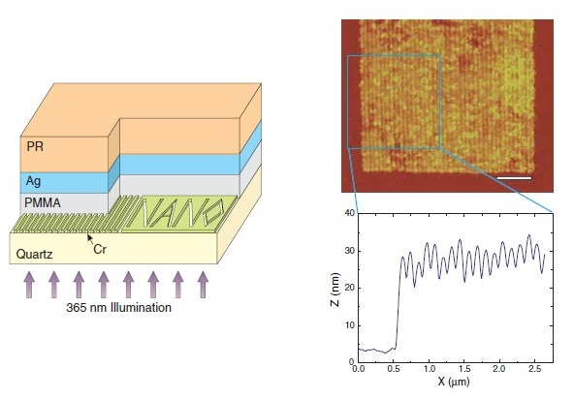
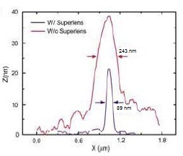
Application
Full width at half maximum line width
N. Fang, et al. Sub–Diffraction-Limited Optical Imaging with a Silver Superlens. Science, 308, 534-537 (2005).
11

Slide 12
QED Analysis
The diffraction-limited wavelength P* for PMMA with n = 1.5 illuminated with UV at 365 nm is, P* = 365/1.5 = 243 nm.
PMMA = polymethyl methacrylate
The silver film absorbs the light P* of the diffraction-limited image, the heat conserved by the creation and emission of light at wavelength λ = 2 nd
QED induces the silver films having thickness d = 35 nm to emit light at sub-diffraction wavelength λ . Silver having n = 1.28 at P* = 243 nm produces sub-diffraction light at λ = 2 (1.28) 35 = 89.6 nm.
12

Slide 13
Conclusions
QED is proposed as an alternative to transformative optics in enhancing diffraction-limited images.
QED does not rely on evanescent waves, but by QM precludes conservation of light from the diffraction-limited image P* by a change in temperature.
Instead, simple QED conserves the light from the diffraction-limited P* image to create wavelength λ < P*
that enhances image quality.
13

Slide 14
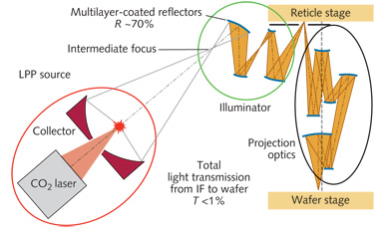
Extensions
LPP lithography at 13.5 nm challenged Moore’s law
LPP = laser produced plasma
LPP uses high power CO2 lasers to vaporize solid targets, the atomic emission producing 13.5 nm EUV light
LPP lithography is both complex and very expensive
14

Slide 15
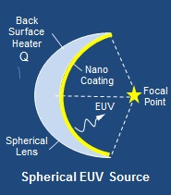
QED Lithography
In contrast, QED lithography is simple and inexpensive
EUV wavelength λ = 2 nd
d = coating thickness
QED induces the conversion of heat supplied to the spherical lens to EUV using d ~ 6.75 nm silver coating →
λ = 2(1)6.75 ≈ 13.5 nm
15

Slide 16
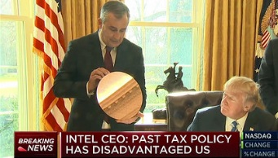
Trump and INTEL
Intel Roadmap 2009
32 nm – 2010
22 nm – 2012
14 nm – 2014
10 nm – 2017
7 nm – 2018
5 nm – 2020
What is the 7 nm process?
Most likely LPP
QED induces EUV at 7 nm using d ~ 3.5 nm silver coating on the lens →
λ = 2(1)3.5 ≈ 7 nm
16

Slide 17
Questions & Papers
Email: nanoqed@gmail.com
http://www.nanoqed.org
17
Notes:
Enter speaker notes here.

