Slide 1
Cosmic Dust and Discovery of Colliding Black Holes
Thomas Prevenslik
QED Radiations
Discovery Bay, Hong Kong
1
Notes:
Enter speaker notes here.

Slide 2
Introduction
Confirmation of Einstein's theory of general relativity based on LIGO measurements of gravitational waves from colliding black holes requires resolution of pico-meter displacements on Earth based interferometers having mirrors separated by 4 km long arms.
2

Slide 3
Problem
LIGO resolution verges on the impossible as the detection sensitivity < 1x10⁻¹⁹ m, far less the size of the proton.
Resolution aside, noise is of particular concern as LIGO measurements of sensitivity over the frequency range from 35 - 250 Hz comprise a continuum of narrow band low frequency spikes
Difficulties in resolution and noise suggest LIGO may not be measuring gravitational waves, but rather sound carried by light somehow produced in the black hole collision?
3

Slide 4
Proposal
In the heat of black holes, NPs of cosmic dust produce light modulated by reflections in the debris of the inspiral and carried to the Earth at frequencies (35 - 250 Hz)
NPs = nanoparticles
NPs < 500 nm diameter amorphous silicate
4

Slide 5
Presentation
Heat Capacity of the Atom
NP Light Source
Bell’s Photophone
Light from Black Hole Pair
Inspiral Modulations
Simulations
Conclusions
5

Slide 6
Heat Capacity of Atom
Classical Physics (MD, Comsol)
Classical Physics (MD, Comsol)
kT 0.0258 eV
QM
(kT = 0)
Nanoscale
Macroscale
1900 → Planck derived the QM law
1912 → Debye’s phonons → hυ = kT → valid for λ > 100 μm
Today, phonons used in NPs ! No conduction in NPs ?
1950 → Teller & Metropolis MD → PBC → valid for λ > 100 μm
Today, MD used in discrete NPs ! MD of nanoscale is invalid ?
How do NPs provide high EM confinement?
NPs have high surface to volume ratios → Heat is absorbed at NP surface → EM confinement of NP atoms occurs over nanoscale wavelengths
6

Slide 7
NP Light Source
In NPs w/o heat capacity, QED converts heat Q into light because QM precludes atoms the heat capacity for conservation to proceed by an increase in temperature.
QM = quantum mechanics QED = quantum electrodynamics
But QED is a simple form of the complex light and matter interaction advanced by Feynman and others
Heat → NP w/o heat capacity → Light
f = (c/n)/λ λ / 2 = d E = h f
Light
λ/2 = d
Heat
Q
λ/2
No
Temperature
Change
7

Slide 8
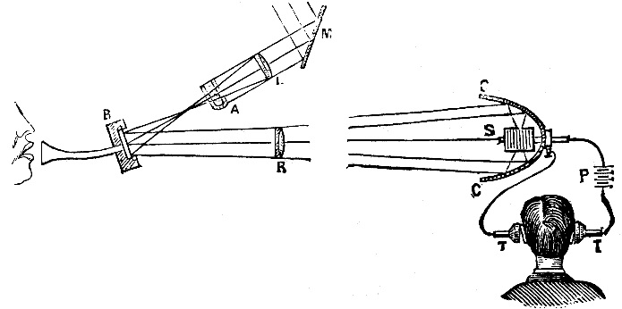
Bell’s Photophone
Almost 40 years before Einstein’s theory of gravitational waves, A. G. Bell transmitted sound over sunlight. A thin-silvered mirror was exposed to human voice from one side and sunlight reflected from the other side that was absorbed in a selenium cell and after amplification produced audible sound.
Bell also observed that sound waves were produced from a solid when exposed to beam of sunlight that was interrupted with a rotating slotted wheel. In a pair of rotating black holes, similarity is found the interruption of light from one black hole by the other.
8

Slide 9
Light from Black Hole Pair
Sky
CCW
Pair
Rotation
White hole interrupts
Yellow light
Yellow hole
interrupts
White light
Sound
carried by light
to
Earth
Earth
9

Slide 10
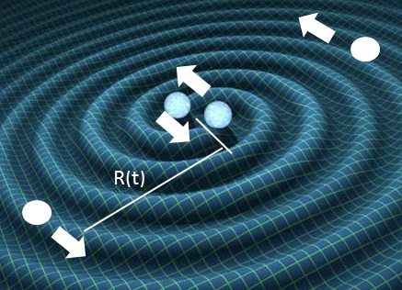
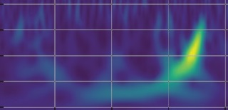
Inspiral Modulation
Frequency - Hz
35 125 500
f = $\frac{V}{2πR(t)}$
0.25 0.30 0.35 0.4 0.45
Time - s
The slower rotating outer region of the inspiral produces the LIGO 35 Hz low frequency, the faster rotating pairs in inner region giving 250 Hz.
10

Slide 11
Assumptions
The Kepler effective black hole separation is given by the Schwarzschild radius R_{S} = 2GM/c²
For M =70 solar masses, M = 1.39 x 10³² kg →
Rs = 2.03 x 10⁵ m
For 2 black holes, the frequency f = 2 $∗ \frac{V}{2πR(t)}$
Fit Rs at 250 Hz → V ≈ 0.5 c
For 1 revolution, the time τ = 0.5/ f
For k revolutions,
$$_{k}=\frac{1}{2}\sum_{1}^{k}{\frac{1}{f_{k}}}$$
11

Slide 12
Simulations
$$_{k}=\frac{1}{2}\sum_{1}^{k}{\frac{1}{f_{k}}}$$
Frequency - Hz
35 125 500
0.25 0.30 0.35 0.4 0.45
Time - s
At R = Rs, f =250 Hz and at R = 7.1 Rs, f = 35 Hz
12

Slide 13
Conclusions
LIGO may not be measuring Einstein's gravitational wave produced in the coalescence of black holes, but rather sound in the merger carried to Earth by light from heated cosmic dust.
But this may not be important because:
LIGO has confirmed the discovery of black hole mergers
– a historic astronomical event in itself !!!
13

Slide 14
Questions & Papers
Email: nanoqed@gmail.com
http://www.nanoqed.org
14
Notes:
Enter speaker notes here.

