Slide 1
Validity of Molecular Dynamics by Quantum Mechanics
Thomas Prevenslik
QED Radiations
Discovery Bay, Hong Kong, China

Slide 2
Introduction
Molecular Dynamics MD is commonly used to simulate heat transfer at the nanoscale in the belief:
Atomistic response using L-J potentials (ab initio) is more accurate than macroscopic finite element FE programs, e.g., ANSYS, COMSOL, etc.
In this talk, I show:
FE gives equivalent heat transfer to MD, but both are invalid at the nanoscale by quantum mechanics QM
And present:
Example of Invalid and valid MD solutions by QM
1

Slide 3
MD and FE Restrictions
MD and FE are restricted by SM to atoms having thermal heat capacity
SM = statistical mechanics
2

Slide 4
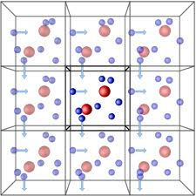
Validity
Historically, MD simulations of the bulk performed under periodic boundary conditions PBC assume atoms have heat capacity
In the macroscopic bulk being simulated, all atoms do indeed have heat capacity
MD is therefore valid for bulk PBC simulations
3

Slide 5
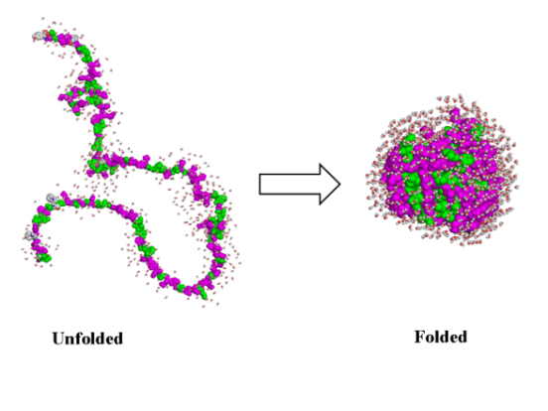
Problem
Today, MD is not used for bulk simulations, but rather for the atomistic response of discrete molecules and nanostructures
Problem is MD programs based on SM assume the atom has heat capacity, i.e.; temperature changes allowed in folding proteins.
But QM forbids temperature changes → unphysical results, e.g.,
Conductivity in Thin films depends on thickness
Nanofluids violate mixing rules,
Heat capacity changes in folding proteins, etc
Why is this so?
Protein Folding
Pretty Pictures?
4

Slide 6
Heat Capacity of the Atom
SM, MD and FE (kT > 0)
kT 0.0258 eV
QM
Nanoscale
Macroscale
At the nanoscale, solutions by SM, MD, and FE are invalid by QM
5

Slide 7
Quantum Corrections
The vanishing heat capacity in the Einstein-Hopf of QM is consistent with making QCs of heat capacity to MD solutions.
QC = quantum corrections
See Allen and Tildesley - Computer Simulations of Liquids, 1987.
QCs show heat capacity vanishes in MD solutions , but is ignored.
Consequence
Pretty pictures of invalid MD solutions abound the literature
6

Slide 8
Conservation of Energy
Lack of heat capacity by QM precludes EM energy conservation in discrete molecules and nanostructures by an increase in temperature, but how does conservation proceed?
Proposal
Absorbed EM energy is conserved by creating QED. induced excitons (holon and electron pairs) at the TIR resonant frequency
_{QED = Quantum Electrodynamics}
TIR = Total Internal Reflection
_{EM = Electromagnetic}
Upon recombination, the excitons emit EM radiation that charges the molecule and nanostructure or is lost to the surroundings.
7

Slide 9
TIR Confinement and QED
In 1870, Tyndall showed photons are confined by TIR in the surface of a body if the refractive index of the body is greater than that of the surroundings.
Why important?
Nanostructures have high surface to volume ratio.
Absorbed EM energy is concentrated almost totally in the nanostructure surface that coincides with the mode of the TIR photon.
Under TIR confinement, QED induces the absorbed EM energy to spontaneously create excitons
f = (c/n)/λ λ = 2D E = hf
D = diameter of NP or thickness of film
8

Slide 10
QED Heat Transfer
EM
Radiation
$Q_{abs}−Q_{Excitons}=Q_{cond}$
Conservation by QED Excitons is very rapid
Qabs is conserved before thermalization only after which phonons respond
$$Q_{abs}=Q_{Excitons}$$
No thermal conduction
$Q_{cond}$ → 0
Fourier temperatures in NP are meaningless
Conductivity remains at bulk
Charge
Excitons
NP
$$Q_{abs}$$
Phonons
Surface
Qcond
9

Slide 11
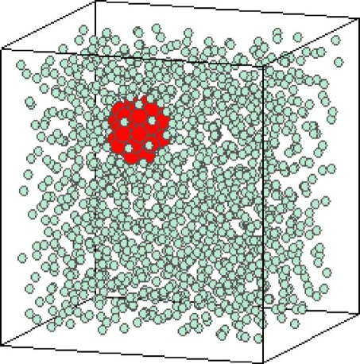
MD - Discrete and PBC
Akimov, et al. “Molecular Dynamics of Surface-Moving Thermally Driven Nanocars,”
J. Chem. Theory Comput. 4, 652 (2008).
Sarkar et al., “Molecular dynamics simulation of effective thermal conductivity and study of enhance thermal transport in nanofluids,”
J. Appl. Phys, 102, 074302 (2007).
MD for Discrete → kT = 0, But MD assumes kT > 0
Car distorts but does not move
Macroscopic analogy,
FE Simulations → Same as MD
Classical Physics does not work
QM differs
No increase in car temperature
Charge is produced by excitons
Cars move by electrostatic interaction
MD for kT > 0 is valid for PBC because atoms in macroscopic nanofluid have kT > 0
Pretty Pictures
Or
Valid MD by QM ?
10

Slide 12
Traditional MD
Traditional MD assumes the atoms have thermal kT energy or heat capacity to conserve EM energy by an increase in temperature
The Nose-Hoover thermostat is used to maintain the specimen at constant ambient temperature.
By SM, temperature creates pressure. Excitons to create charge and produce repulsive Coulomb forces between atoms are not created.
Comparison of MD by Traditional and QM
Nanowire in a Tensile Test
11

Slide 13
NW in Tensile Test NW = Nanowire
Stress-strain tests of silver NWs at Georgia Tech - Z L. Wang.
"Size effects on elasticity, yielding, and fracture of silver nanowires: In situ experiments,” Phys. Rev. B, 85, 045443, 2012.
NWs Stiffen - Higher Yield and Young’s Modulus
Mechanism thought to be the high surface to volume ratio in combination with the annihilation of dislocations from fivefold twinning.
Alternative Proposal
QM denies the NW the heat capacity to increase in temperature to conserve heating – Inelastic strains, etc.
Only heat from grips simulated
12

Slide 14
MD Model
L
w
F
F
w
The NW 38 nm diameter x 1.5 micron long
Modeled in a smaller size comprising 550 atoms in the FCC configuration
Atomic spacing = 4.09 Ȧ.
The NW sides w = 8.18 Ȧ and length L = 87.9 Ȧ.
13

Slide 15
Lennard-Jones Potential
The L-J potential was used to simulate the atomic potential U_{ij} of the NW atoms.
$U_{ij}=4ε\left[{\left(\frac{σ}{R_{ij}}\right)}^{12}−{\left(\frac{σ}{R_{ij}}\right)}^{6}\right]$
where, R_{ij} the interatomic spacing between atoms i and j.
For silver, σ = 2.644 Ȧ and ε = 0.345 eV.
14

Slide 16
Electrostatic Energy
To obtain valid MD solutions, replace thermal energy UkT of the atom by equivalent electrostatic energy UES from the QED induced charge by excitons.
$$F_{ij}=η\frac{e^{2}}{4ε_{o}R_{ij}^{2}}$$
$$U_{kT}=\frac{3}{2}kT_{grip}$$
$$U_{ES}=\frac{3e^{2}}{20ε_{o}R_{atom}}$$
$$=\frac{U_{kT}}{U_{ES}} =\frac{10ε_{o}k{R_{atom}T}_{grip}}{e^{2}}=0.0065 at 300 K$$
15

Slide 17
Equilibration
To simulate the QM restriction that the NW cannot increase in temperature upon being held in the grips of the testing machine, the MD model is equilibrated by running for 5000 iterations maintaining a temperature of 0.01 K with the Nose-Hoover thermostat and a time step < 5 fs.
Loading
The axial stretching of the NW was simulated imposing a step displacement Δ and holding the displacement for 5000 iterations. The force F is:
$$F=\frac{AE}{L}Δ$$
A = area and L = length
Electrostatic energy imposed and temperature held at 0.01 K
16

Slide 18
Stress Computation
The σ_{x}, σ_{y}, and σ_{z} stresses are computed from the virial theorem,
$$_{ij}^{V}= \frac{1}{V}\sum_{}{\left[\frac{1}{2}\sum_{β=1}^{N}{\left(R_{i}^{}−R_{i}^{β}\right)F_{j}^{β}}−m^{}v_{i}^{}v_{j}^{}\right]}$$
where, the positions of atoms α and β are R_{i}^{α} and R_{i}^{β}, and thermal velocities $v_{i}^{}$ and $v_{j}^{}$
The thermal velocity $v_{i}^{}$ of the atoms is required to be included in the virial, but sometimes is not. → Controversy
Resolved by QM as temperature changes are precluded at the nanoscale. (Atoms in the NW are not thermally excited)
17

Slide 19
NW in Uniaxial Tension (Traditional MD - Macroscale Tensile Test)
18

Slide 20
NW in Triaxial Tension (MD by QM – Nanoscale Tensile Test)
19

Slide 21
MD - NW Summary
MD solutions valid by QM require the thermal energy of the heating in the tensile test to be conserved in by Coulomb repulsion instead of by an increase in temperature
The 8 Ȧ square silver NW fits data at η = 0.001 means 1/6.5 = 15 % of the kT energy stiffens the NW, the remaining 85% lost as EM radiation to surroundings.
MD simulation
In the uniaxial stress state, Young’s modulus Yo ~ 17 x 10⁶ psi,.
In the triaxial stress state, Young’s modulus of the NW is Y ~ 31x10⁶ psi. The stiffening enhancement is Y/Yo ~ 1.88.
The 8 Ȧ square NW was simulated for 550 atoms with a PC. Actual NW having diameters of 34 nm x 1 micron long require ~ 350 million atoms Far larger computation resources!!!
20

Slide 22
Conclusions
MD based on SM assuming atoms have kT energy is valid for PBC
MD and FE provide equivalent heat transfer simulations of molecules and discrete nanostructures, but are invalid by QM giving unphysical results
QM negates SM and thermal conduction at the nanoscale
Valid MD of molecules and nanostructures requires conservation of absorbed EM energy by the creation of charge instead of temperature.
Extension
QM and MD - QM and other Applications on Homepage
Expanding Universe
21

Slide 23
Expanding Universe
Prior to 1910, astonomers beleved the Universe was static and infinite
In 1916, Einstein‘s theory of relativity required an expanding or contracting Universe
In 1929, Hubble measured the redshift of galaxy light that by the Doppler Effect showed the Universe was inferred to be expanding.
But you probably do not know
Cosmic dust of submicron NPs permeate space and redshift galaxy light without Universe expansion
22

Slide 24
Redshift in Cosmic Dust
Based on classical physics, astronomers assume absorbed galaxy photon increases temperature of cosmic dust NPs
Galaxy Photon
Lyman Alpha - λ = 121.6 nm
Redshift
Redshift Photon
$$Z= \frac{λ_{o}−λ}{λ}$$
λ_{o} = 2nD > λ
D = 300 nm, n = 1.5 → λo = 900 nm
Z = 6.4
NP
$$\frac{V}{c}= \frac{{\left(Z+1\right)}^{2}−1 }{{\left(Z+1\right)}^{2}+1}$$
→ 0.966 !!!
QED under TIR
Surface Absorption
Redshift Z > 1 without Universe expansion
23

Slide 25
2013 Nobels
The Nobel in physics for the Higgs field is not needed to explain dark energy and matter as Universe not expanding because of cosmic dust
The Nobel in Chemistry gives a simplified MD procedure, but is invalid because the vanishing heat capacity required by QM is excluded.
24

Slide 26
Questions & Papers
Email: nanoqed@gmail.com
http://www.nanoqed.org
25
Notes:
Enter speaker notes here.

