Slide 1
Immunogenicity by Aggregation of Therapeutic Proteins from UV produced by the Aggregates themselves
Thomas Prevenslik
QED Radiations
Discovery Bay, Hong Kong
1
Notes:
Enter speaker notes here.

Slide 2
Introduction
Protein therapeutics are used in the treatment of Alzheimer and Parkinson.
A major concern is that repeated administration to patients often leads to undesirable antidrug antibodies (ADAs) that induce immunogenicity described as an adverse response of the immune system.
It is generally thought the ADAs are triggered by the tendency of monomer protein molecules to aggregate. The aggregates known to elicit ADA response are globular proteins having molecular weights from 6 -100 kDa and diameters from 3 – 10 nm
The aggregates are comparable to inorganic NPs that based on QM have been linked to DNA damage by the natural emission of low-level QED induced EM radiation beyond the UV.
NPs = nanoparticles
QM = quantum mechanics QED = quantum electrodynamics EM = electromagnetic.
2

Slide 3
Hypothesis
Self assembly of therapeutic proteins occurs from polarization under QED induced EM radiation beyond the UV in NPs of protein aggregates. VDW or contrived forces not necessary.
The NP aggregates themselves produce the UV radiation
3

Slide 4
Background
Immunogenicity by aggregates finds similarity with DNA damage by QED induced radiation that claims inanimate man-made NPs in body fluids emit low-levels of UV radiation that may lead to cancer.
Cancer research is only beginning to recognize the remarkable fact that inanimate NPs in body fluids damage DNA by the same reaction pathways as conventional sources of UV radiation.
But biological NPs < 100 nm also emit UV provided the NPs have a refractive index n greater than the water surroundings. For cancer cells, the index varies from n =1.34 to 1.38. For proteins, n = 1.41
Condition satisfied for water with n = 1.33.
4

Slide 5
Biological Nanoparticles
Disorganization of Epithelial Tissue
Epithelial tissue forming the outer layers of the skin is organized by a submicron thick < 100 nm basement membrane that upon breakdown into NPs is associated with the spread of tumors.
Exocytosis of Small Proteins
The exocytosis of fusion products into the extracellular fluid through the tumor cell membrane is known to produce onco proteins. QED induced radiation at UV levels from biological NPs during exocytosis is consistent with malignancy.
Molecular Markers in Cancer Detection
Changes that occur in cancer cells compared with normal tissue can be detected in body fluids and used as molecular markers of cancer. As an epithelial tumor grows, cancer cells fragment into NPs from the organ epithelium and enter the body fluid to assist cancer growth.
5

Slide 6
Theory
Nanoparticles
QM Restrictions
TIR Confinement
6

Slide 7
Nanoparticles
Refractive Index n of NPs > that of the surroundings
No Temperature change in conserving these sources of absorbed EM energy because by QM the heat capacity vanishes
EM
Radiation
or
Charge
Light
Laser/Supernovae
Photons
Nanoparticles
Molecular
Collisions
Nanofluids
Biology
7

Slide 8
QM Restrictions
Classical Physics
kT 0.0258 eV
QM
Nanoparticles
8
By QM, heat capacity of NPs vanishes

Slide 9
TIR Confinement
The high surface to volume ratio of NPs creates QED photons by trapping absorbed EM energy at the TIR resonance of the NP surface. No dangling bonds.
The QED photons created:
f = (c/n)/λ λ = 2d E = hf
d = NP diameter
n = 1
NP
n > 1
9

Slide 10
Application
CEWL – Chicken Egg-white Lysozyme
Problem / Resolution
TEM Image
Collisions of Water Molecules
MD Simulation
Discussion
10

Slide 11
CEWL Aggregates*
UV illumination of Unfolded CEWL forms uniform globular aggregates.
CEWL undergoes conformational changes resulting in the exposure of hydrophobic residues upon the dissociation of the native disulfide bonds by UV illumination and self-assemble into globular aggregates.
Upon UV radiation at 200 μW/cm² at room temperature, the aggregates start to form observable aggregates of diameters 30 nm after 10 min .
* J. Xie, et al., “Mechanistic insight of photo-induced aggregation of chicken egg white lysozyme: The interplay between hydrophobic interactions and formation of intermolecular disulfide bonds,” Proteins, vol. 79, pp. 2505–2516, 2011.
11

Slide 12
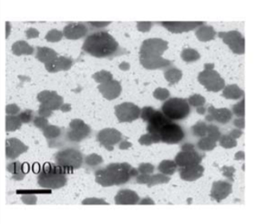
TEM Image
TEM image is after 72 hours
Scale bar = 1000 nm
12

Slide 13
Problem
Immunogenicity of therapeutic drugs under UV radiation does not occur naturally except perhaps in the UV content of sunlight.
Protein aggregation based on UV radiation in the CEWL experiment is therefore not relevant to clinical immunogenicity
Unless a source of UV radiation can be found in the body.
Resolution
Immunogenicity is caused by the photochemical activation of disulfide bonds under the UV radiation created by the protein aggregates themselves.
In the human body, the source of EM energy that creates the UV driven immunogenicity is the collision of water molecules
13

Slide 14
Molecular Collisions
The collision power Q_{C} of water molecules of mass m transferred to an aggregate having diameter d is,
$$Q_{C}=\frac{π}{2\sqrt{3}}pPd^{2}\sqrt{\frac{kT}{m}}$$
where, p is the probability of full kT energy transfer for inelastic collisions and P is ambient pressure. The mass m = MW/ N_{Avag} where MW = 18 and N_{Avag} is Avagadro’s number.
14

Slide 15
Response
Variation of Planck energy E and Power Q_{C} with aggregate diameter d
Refractive index n = 1.4 with probability p = 10⁻⁷
selected to approach the UV lamp response
15

Slide 16
MD Simulation
Polarization Force
$$F=4πα\frac{∂U}{∂x}$$
EM Energy Density
$$U=\frac{Q_{C}}{πd^{3}/6}\left(\frac{πd^{2}}{4πx^{2}}\right)\int{dt}=\frac{3}{2πd}\frac{Q_{C}}{x^{2}}Δt$$
Self - Assembly Force
$$F=−\frac{12α}{d}\frac{Q_{C}}{x^{3}}Δt$$
16

Slide 17
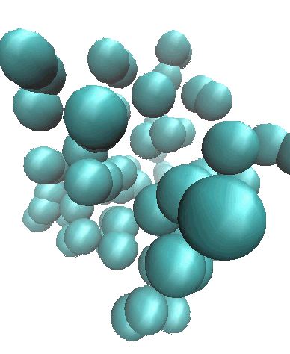
VMD Response
17

Slide 18
Discussion
The CEWL tests using a UV-B lamp 200 μW/cm² may be approximated by collisions of water molecules at a probability p = 10⁻⁷ .
More study is required to establish the actual UV level the CEWL tests and the probability of inelastic collisions
18

Slide 19
Conclusions
Protein most likely aggregate by the UV radiation produced by the aggregates themselves
MD simulation shows QED radiation from NPs rapidly assembles into globular proteins.
Hydrophobicity provides a distinct change in refractive index at the surface of the aggregate.
Agents that destroy hydrophobicity are recommended to reduce immunogenicity.
By QED theory, immunogenicity by protein aggregates is similar to DNA damage by inanimate or biological NPs in that both convert collisional energy by water molecules to EM radiation beyond the UV .
19

Slide 20
Questions & Papers
Email: nanoqed@gmail.com
http://www.nanoqed.org
20
Notes:
Enter speaker notes here.

