Slide 1
Simple QED: The Absorption in Raman Scattering?
Thomas Prevenslik
QED Radiations
Berlin 10777, Germany
1
Notes:
Enter speaker notes here.

Slide 2
Introduction
Simple QED is a heat transfer process applicable to nanostructures e.g., nanoparticles (NPs).
Similar to inelastic Raman scattering, simple QED changes the frequency of incident light.
Simple QED does not follow elastic Mie theory
Simple QED has nothing to do with Feynman’s QED
2

Slide 3
Classical Physics
Classical physics allows the atom to have heat capacity at the nanoscale, the conservation of heat proceeding by a change in temperature.
However, heat transfer at the nanoscale is controlled by the Planck law of quantum mechanics differing significantly from classical physics as,
The Planck law denies atoms in nanostructures the heat capacity to conserve heat by a change in temperature
→
3

Slide 4
Planck law
$$E=\frac{\frac{hc}{λ}}{exp\left(\frac{hc}{λkT}\right)−1}$$
kT decreases for λ < 200 microns
and vanishes for λ < 0.1 microns = 100 nm
No kT heat capacity at Nanoscale
4

Slide 5
Nanotechnology
Nanotechnology has generally ignored the Planck law and continued to use classical physics → Many meaningless papers in the literature.
Researchers in nanoscale heat transfer have not appreciated the significant difference between classical physics and the Planck law with regard to the heat capacity of the atom.
5

Slide 6
Heat Transfer w/o Temperature?
Heat transfer w/o temperature precludes the Fourier law of heat conduction in nanoscale heat transfer.
The Stefan-Boltzmann law for radiative heat transfer depending on temperature is not applicable.
Molecular Dynamics w/o PBC assume atoms in nanostructures have temperature.
An alternative is to formulate nanoscale heat transfer based on the Planck law → simple QED
6

Slide 7
Simple QED
Simple QED is a method of nanoscale heat transfer that conserves heat with EM radiation instead of temperature.
QED stands for quantum electrodynamics, a complex theory based on virtual photons advanced by Feynman.
Simple QED is a far simpler theory that only requires the heat capacity of atoms to vanish allowing conservation by real photons as EM waves standing across nanostructures
7

Slide 8
Quantum States
Unlike electron level quantum states, simple QED quantum states are size dependent based on the dimension over which the EM waves stand.
The Planck energy E of the simple QED state assumes the time τ for light to travel 1 cycle across and back dimension d at light speed c corrected for the index n of refraction is, τ = 2d/(c/n). Hence,
E = h/τ = hc/2nd
λ = 2nd
8

Slide 9
EM Confinement
Interaction of the light occurs with the NP surface because of the high surface-to-volume ratio of NPs.
For light having wavelength λ >> d, the light is absorbed in penetration depth δ of the NP surface
Light
λ >> d
The light Q absorbed in thickness δ
is the EM confinement
that creates standing waves
Light
Q
d
δ
NP
For an elliptical NP, the simple QED photon stands across the Fermat minimum diameter d
Simple QED
Photon
9

Slide 10
EM Confinement (cont’d)
Consider a iron NP creating a UVC (254 nm) photon at E = 4.88 eV. For n = 1.5, d = λ /2n ∼ 85 nm.
Confinement of the light Q while creating the UVC standing wave requires EM confinement at least equal to the Planck energy Q = E
The pressure P acting on the surface is given for a bulk modulus B and volume strain ΔV/V by, P = B⋅ΔV/V = 6⋅δ⋅B/d.
But P = E / V = 6E/πd³ giving δ = Q/πBd². For iron, B = 1.6x10¹¹ Pa, the absorption depth δ of a single UVC δ ∼ 0.2 fm
10

Slide 11
Application
Spherical iron NP a liquid bath
Q
The NP by conduction absorbs heat Q from the thermal bath temperature T.
E
Fourier law valid for kT =1, but not kT < 1.
The radius Rs which bath atoms at 300 °K have thermal kT energy is given by the Planck law λ ∼ 200 microns. For index n = 1.4, Rs = λ/4n ∼ 36 μm.
2Rs
Q
NP
d
Q
kT < 1
kT = 1
E
Heat flow Q from the bath at Rs is converted to far IR (λ ∼ 200 μm) and upon absorbed by the NP emits simple QED radiation E = hc/2nd.
E
E = hc/2nd
Q
11

Slide 12
Application(cont’d)
Simple QED conserves thermal energy U = 1.5 N⋅kT by creating standing EM radiation inside the NP.
For the 85 nm iron NP, the number N of iron atoms is, N = (ρV/55)⋅Av, ρ = 7854 kg/m^{.3}, V = πd³/6 = 3.21x10⁻²² m³, and Av is Avagadro's number = 6.023 x 10²⁶ atoms/kg-mol. Hence, N ∼ 2.7x10⁷ and U ∼ 1 MeV .
Since 1 UVC photon energy E = 4.88 eV,
∼ 200,000 UVC photons / NP
But the UVC photon must be created promptly,
< 5 fs is required
12

Slide 13
Application(cont’d)
Required
Creation
Time
Heating of the bath at Rs by a single UVC photon,
For Δt ∼ 1 fs, Q = E/Δt ∼ 780 μW.
Temperature increases ∼ 2 μ°C and recovers in < 1 ps.
13

Slide 14
Application(cont’d)
Need much higher Bath temperature to create UVC photon
But once the incident EM radiation is absorbed in the penetration depth δ = 0.2 fm of the NP,
what is the creation time of the UVC photon ?
One cycle for light to travel across the NP diameter was shown τ = 2d/(c/n). For the 85 nm NP, τ = 0.85 fs.
UVC creation time τ < 5 fs and acceptable.
The time to create the EM radiation depth δ is longer, but once formed UVC creation is very fast.
14

Slide 15
Application(cont’d)
Humans have ( ∼ 1x10¹³ cells ) and each cell has 10,000 DNA breaks / day ∼ 10¹² DNA breaks/s.
The time for a NP in the bath to create a single UVC photon ∼ 1 ps is comparable to the 10¹² DNA breaks/s for the total human body !!!
Although NP induced DNA damage in humans is high, our immune system compensates for DNA damage as it did for the intense UVC on the early Earth?
15

Slide 16
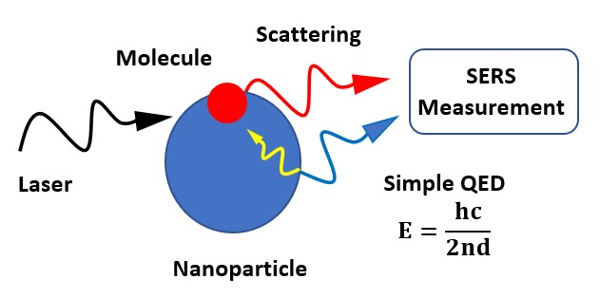
SERS
Surface Enhanced Raman Spectroscopy (SERS) is inelastic scattering similar to simple QED in that incident and scattered light have different wavelengths.
Simple QED differs from SERS as absorbed incident light is emitted by size dependent states of NPs.
For CW lasers, light may redshift or blueshift
But for single photon light, only redshift possible.
16

Slide 17
Maxwell Simulations
Simple QED suggests modifications of Maxwell simulations in nanoscale regions of macroscopic structures to conserve heat by EM radiation instead of an increase in temperature.
Maxwell simulations of nanoscale regions need to include size dependent EM emissions.
17

Slide 18
Evanescent Waves
Evanescent waves require a thermal origin.
But the Planck law precludes temperature fluctuations in nanoscale films as heat capacity vanishes.
Transformative Optics* based on evanescent waves cannot explain enhanced image quality because evanescent waves cannot exist in nanoscale films.
*T. Prevenslik, Superlens by Transformative Optics or QED?, IWT Workshop 2017.
18

Slide 19
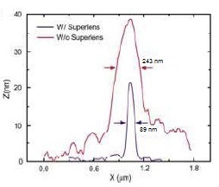
Transformative Optics
Simple QED induces silver film thickness d = 35 nm to emit light at sub-diffraction wavelength λ = 2nd .
The diffraction-limited wavelength P* for PMMA ( n = 1.5) under UV (365 nm) is, P* = 365/1.5 = 243 nm.
Irradiation of silver (n = 1.28) by (P* = 243 nm) light → λ = 2nd
λ = 2 (1.28) 35 = 89.6 nm.
18

Slide 20
Dark Matter
Simple QED converts the galaxy photon as a particle to a wave in cosmic dust and back to a redshifted particle.
Galaxy Photon
(E = hc/λ)
NP
Redshift
Photon
(E = hc/2nd)
Wave
In 1970, the M31 redshift of the Nll line at 658.3 nm was
z ∼ 0.001 giving velocity ∼ 300 km/s.
But M31 velocity is << 300 km/s → Dark Matter !!!
Cosmic dust permeates the Universe.
For n = 1.3, d $=$ (z + 1)λ/2n ∼ 253 nm
Dark Matter does not exist !!!
19

Slide 21
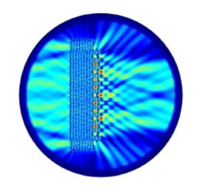
Conclusion
λ = 2 nd ?
20

Slide 22
Questions & Papers
Email: nanoqed@gmail.com
http://www.nanoqed.org
21
Notes:
Enter speaker notes here.

