Slide 1
Dust and the Origin of the Universe
Thomas Prevenslik
QED Radiations
Hong Kong and Berlin
Notes:
Enter speaker notes here.

Slide 2
Preface
Dust may be an annoyance in our everyday view of what we see on Earth,
but
Cosmic dust that permeates interstellar space also affects what we see and is important in our understanding of the origin of the Universe
1

Slide 3
Introduction
In 1926, Hubble’s redshift measurements of light from distant galaxies suggested the Universe was expanding thereby supporting Einstein’s GR theory
GR = general relativity
The expanding Universe was based on velocity measurements of distant galaxies inferred from Doppler redshifts of light
2

Slide 4
Observation
Galaxy velocities from redshift have led science to believe the Universe is expanding and dark matter is necessary to hold galaxies together
GR is questionable, because galaxy velocities from redshift are overstated by cosmic dust
Proposal
3

Slide 5
Quantum Mechanics v. Classical Physics
Classical physics allows atoms in quantum sized cosmic dust particles to fluctuate in temperature
Planck law of QM forbids temperature fluctuations under high EM confinement
$$E=\frac{\frac{hc}{λ}}{exp\left(\frac{hc}{λkT}\right) −1}$$
λ - EM wavelength
4

Slide 6
EM Confinement
High EM confinement of atoms in cosmic dust is a natural consequence of high S/V ratios
S/V = surface-to-volume
Upon absorption of galaxy light, almost all of the photon energy is deposited in the dust surface
EM confinement occurs as the dust temperature cannot increase to relieve the surface heat by thermal expansion.
5

Slide 7
Optical Redshift
Measured redshift
$$Z_{meas}=\frac{Δ}{}=\frac{\left({Δ}_{V}+{Δ}_{D}\right)}{}$$
Z_{V} = Δλ_{V}/λ recession redshift
Z_{D} = Δλ_{D}/λ cosmic dust redshift
$$Z_{meas}=Z_{V}+Z_{D}$$
6

Slide 8
Doppler Shift
Galaxy velocity measurement
$$\frac{V}{c}=\frac{{\left(Z_{meas}+1\right)}^{2}−1}{{\left(Z_{meas}+1\right)}^{2}+1}$$
For Zmeas << 1,
$$\frac{V}{c}∼ Z_{meas}$$
In 1970, M31 redshift of the NII line at 6583 Å
$Z=\frac{Δλ}{λ}$ < $0.001= \frac{6.583}{6583}$ → V < $3 x {10}^{8}∗0.001=300 km/s$
7

Slide 9
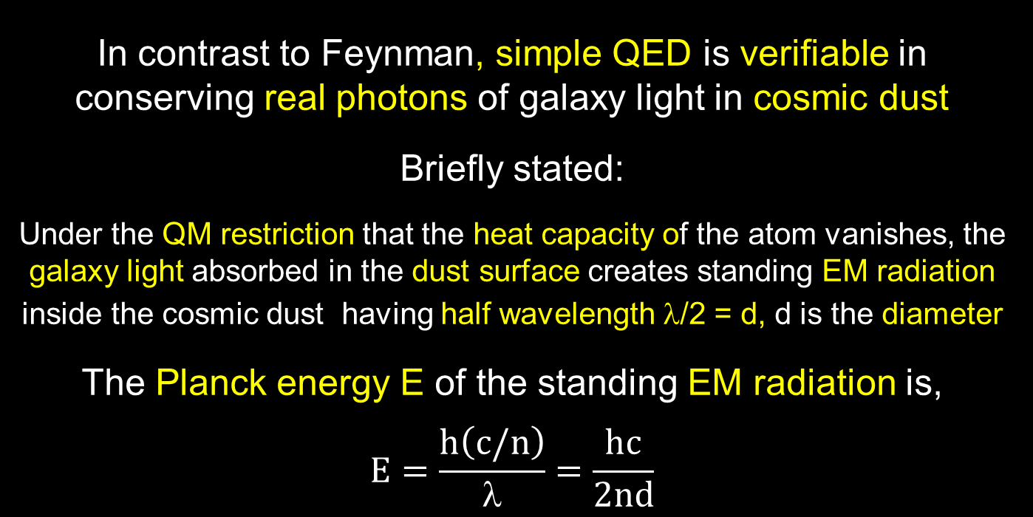
Simple QED
In contrast to Feynman, simple QED is verifiable in conserving real photons of galaxy light in cosmic dust
Briefly stated:
Under the QM restriction that the heat capacity of the atom vanishes, the galaxy light absorbed in the dust surface creates standing EM radiation inside the cosmic dust having half wavelength λ/2 = d, d is the diameter
The Planck energy E of the standing EM radiation is,
$$E=\frac{h\left(c/n\right)}{λ}=\frac{hc}{2nd}$$
8

Slide 10
Summary
Simple QED converts the galaxy photon as a particle to a wave in cosmic dust and back to a redshifted particle
Galaxy Photon
(hc/λ)
Redshift
Photon
(hc/2nd)
λ/2
High S/V ratios
No
Temperature
Change
$$Z_{D}=\frac{\left(2nd−λ\right)}{λ}$$
9

Slide 11
Discussions
Universe Expansion
Dark Matter
10

Slide 12
Universe Expansion
In 2001, SN was found brighter than expected by redshift → accelerated Universe expansion.
Expanding Universe is an illusion caused by cosmic dust Z_{D} > 0 !
Brightness
O
Z_{V}
SN
Redshift
O
Z_{V}
+ Z_{D}
SN
11

Slide 13
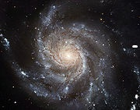
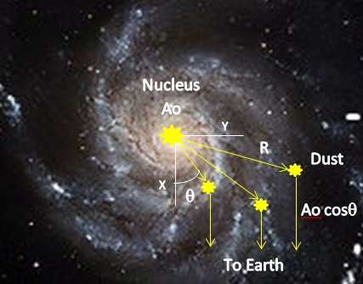
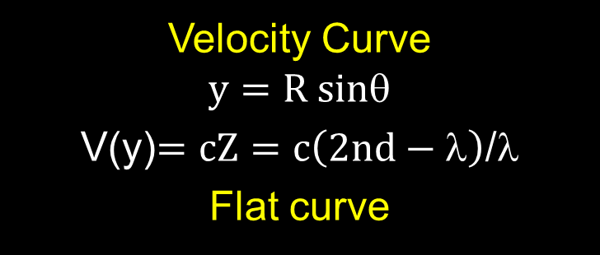
Dark Matter
In 1970’s, Spiral galaxy M31 found to have a flat velocity curve → dark matter
V
Z_{D}
Z_{V}
Velocity Curve
$$y=R sin$$
V(y)$=cZ=c\left(2nd−λ\right)$/$$
Flat curve
Flat velocity curve caused by cosmic dust, not dark matter !
12

Slide 14
Conclusion
By credibly refuting current cosmology for dark matter and Universe expansion, perhaps cosmology may return from GR in an expanding Universe to Newtonian mechanics in a static and dynamic Universe.
13

Slide 15
Questions & Papers
Email: nanoqed@gmail.com
http://www.nanoqed.org
14
Notes:
Enter speaker notes here.

