Slide 1
QED Disinfection of Drinking Water in the Developing World
Thomas Prevenslik
QED Radiations
Discovery Bay, Hong Kong
1
Notes:
Enter speaker notes here.

Slide 2
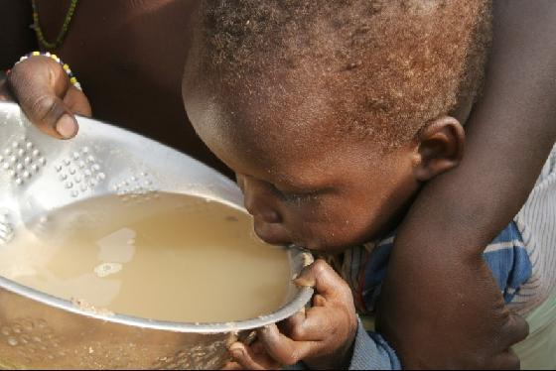
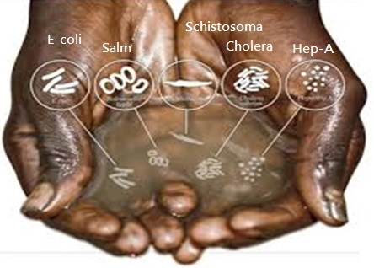
Introduction.
WHO/UNICEF estimates 1 billion people in the developing world do not have access to safe drinking water.
Electricity to boil water as in China is not available
Bottled water if available is too costly
Boiling water by building a fire is not convenient in West Africa
What to do?
2

Slide 3
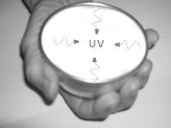
Proposal
QED induced EM radiation from body heat in a hand-held nano-coated aluminum bowl provides the UV- C to inexpensively disinfect water without electricity.
QED = quantum electrodynamics
EM = electromagnetic.
UV-C = UV at 254 nm
Drinking Bowl
3

Slide 4
Operating Principle
QED converts body heat from the hand holding the bowl to UV-C radiation because the temperature of the nano-coating cannot increase by QM.
QM = Quantum Mechanics
4

Slide 5
Nano Coating
Applying a nano coating to a surface avoids natural convection and conserves body heat by emission of QED radiation instead of the usual temperature increase
Heat transfer - 3 modes: Conduction, Radiation, Convection
Suggests:
QED is the FOURTH mode of Heat Transfer?
5

Slide 6
4th Mode of Heat Transfer
Natural convection
QED Radiation
Macro Coating Temperature increase
Nano Coating < 100 nm
No temperature increase
Substrate
Body heat
Nano Coating conserves body heat without temperature increase as QED radiation bypasses natural convection to enhance heat transfer
6

Slide 7
Theory
Heat Capacity of the Atom
Conservation of Energy
TIR Confinement
Refractive Index
7

Slide 8
Heat Capacity of the Atom
Classical Physics (MD, Comsol)
kT 0.0258 eV
Classical Physics (MD, Comsol)
kT 0.0258 eV
QM
(kT = 0)
In nano coatings, the atom has no heat capacity by QM
8

Slide 9
Conservation of Energy
How does EM conservation proceed?
Proposal
Absorbed EM energy is conserved by creating QED radiation inside the nano coating - by frequency up - conversion to its TIR resonance
TIR = Total Internal Reflection
9

Slide 10
TIR Confinement
If the refractive index n of the nano coating is greater than that of surroundings, the QED radiation is confined by TIR
Nano coatings have high surface to volume ratio →
TIR confines a standing wave inside the coating that is then released as QED radiation
f = ( c/n) / λ λ / 2 = d E = hf
d
Heat
QED
Radiation
10

Slide 11
Refractive Index
ZnO coating (n = 2.5) on aluminum (n = 1), improved BHT 4-10 times
OSU, 2010
BHT = Boiling Heat Transfer
Graphene [carbon (n = 2.42)] on silicon dioxide (n = 1.42)
Improved BHT > 2 times
Korea
Scientific Reports , 4, 6276 (2014)
11

Slide 12
Application
Analysis
Coating Selection
Body Heat
Disinfection Dosage
12

Slide 13
Analysis
For ZnO (n = 2.4) , UV-C requires thickness about 50 nm
13

Slide 14
Coating Selection
Initially, ZnO coating (n = 2.5) on aluminum (n = 1) bowl.
But what about zinc toxicity?
Currently, Al₂O₃ ( n = 1.42) by anodizing the aluminum (n = 1) bowl requires 90 nm thickness to produce UV-C
Avoids toxicity as anodized surface may be sealed
Still not decided
14

Slide 15
Body Heat
Total human body heat is about 100 W.
Since the average surface area for adult men and women is about 1.75 m², the body heat Q is,
Q = 57.1 W/m² = 5.71 mW / cm²
Is body heat Q sufficient to disinfect water?
15

Slide 16
Disinfection Dosage
The US HEW guidelines for UV-C light disinfection require a minimum dose of 16 mJ / cm², but recently the National Sanitation Foundation International set 38 mJ / cm²
For body heat Q = 5.71 mW / cm² , the water must be held in the bowl for 7 seconds
Body heat for 10 seconds giving a dosage of 60 mJ / cm²
is sufficient for water disinfection
16

Slide 17
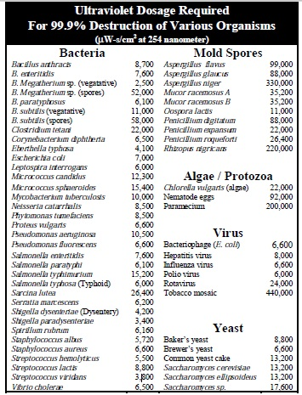
Body Heat for 10 seconds is sufficient to remove
All Bacteria / Yeast
and
Most Spores / Virus
< 60 mJ / cm²
17

Slide 18
Extensions
QED Apps not limited to drinking water
Ebola – West Africa
Smartphones - Everywhere
Body Heat Flashlights - Canada
18

Slide 19
EBOLA
Turn drinking bowl over for Ebola disinfection on near surfaces
Ebola dosage = 0.4 mJ / cm² → 1 second scans
Sufficient for disinfection
19

Slide 20
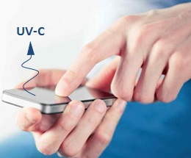
Smartphones – Everywhere
Add ZnO coating to touch screen
Hand + Electronics Heat → Disinfection
20

Slide 21
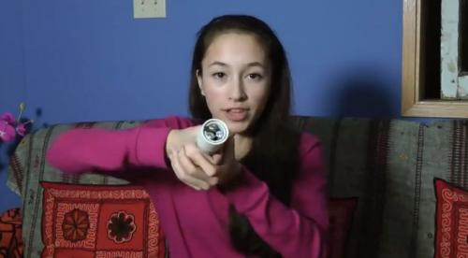
Flashlight by Body Heat
Ann Makosinski - 16 year old - Canada
Peltier Effect + LED → VIS light by body heat
Google → 25 K USD in contest
QED supersedes UV-C LEDs?
21

Slide 22
Collaboration
The applications of QED induced UV-C radiation in the disinfection of infectious diseases are numerous and diverse, the development of which is beyond the capability of the author.
Collaboration with interested parties is solicited.
Or just do it yourself and send me results
22

Slide 23
Questions & Papers
Email: nanoqed@gmail.com
http://www.nanoqed.org
23
Notes:
Enter speaker notes here.

