Slide 1
Nanotechnology in the Disinfection of Drinking Water
Thomas Prevenslik
QED Radiations
Discovery Bay, Hong Kong
1
Notes:
Enter speaker notes here.

Slide 2
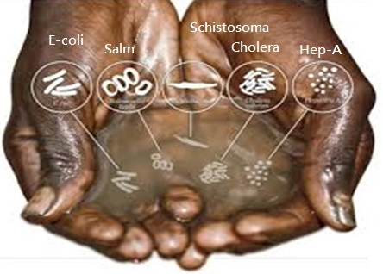
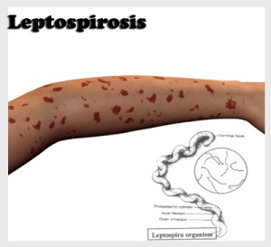
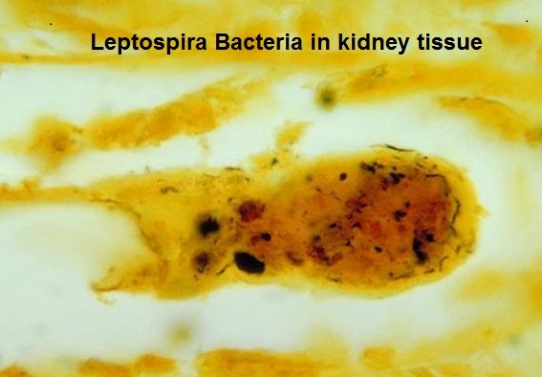
Introduction.
WHO/UNICEF estimates 1 billion people world-wide do not have access to safe drinking water.
.
In Sri Lanka,
10% population do not have safe water
Leptospirosis damages kidneys and liver
Bottled water if available is too costly
Boiling water is not convenient
Electricity to boil water is not always available
What can be done?
2

Slide 3
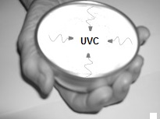
Proposal
QED induced EM radiation from body heat in a hand-held nano-coated aluminum bowl provides the UV- C to inexpensively disinfect water without electricity.
QED = quantum electrodynamics
EM = electromagnetic.
UV-C = UV at 254 nm
Drinking Bowl
3

Slide 4
Operating Principle
QED converts body heat from the hand holding the bowl to UV-C radiation because the temperature of the nano-coating cannot increase by QM.
QM = Quantum Mechanics
4

Slide 5
Nano Coating
Applying a nano coating to a surface avoids natural convection and conserves body heat by emission of QED radiation instead of the usual temperature increase
Heat transfer - 3 modes: Conduction, Radiation, Convection
Proposal:
QED is the FOURTH mode of Heat Transfer?
5

Slide 6
4th Mode of Heat Transfer
Natural convection
QED Radiation
Macro Coating Temperature increase
Nano Coating < 100 nm
No temperature increase
Substrate
Body heat
Nano Coating conserves body heat without temperature increase as QED radiation bypasses natural convection to enhance heat transfer
6

Slide 7
Background
ZnO coating (n = 2.5) on aluminum (n = 1), improved BHT 4-10 times
OSU, 2010
BHT = Boiling Heat Transfer
Graphene [carbon (n = 2.42)] on silicon dioxide (n = 1.42)
Improved BHT > 2 times
Korea
Scientific Reports , 4, 6276 (2014)
7

Slide 8
Theory
Heat Capacity of the Atom
Conservation of Energy
EM Confinement
8I

Slide 9
Heat Capacity of the Atom
Classical Physics (MD, Comsol)
kT 0.0258 eV
Classical Physics (MD, Comsol)
kT 0.0258 eV
QM
(kT = 0)
In nano coatings, the atom has no heat capacity by QM
9

Slide 10
Conservation of Energy
How does EM energy conservation proceed?
Proposal
Absorbed EM energy is conserved by creating QED radiation inside the nano coating - by frequency up - conversion to its EM resonance
10

Slide 11
EM Confinement
Nano structures have high surface to volume ratio →
Absorbed EM energy concentrated in the surfaces temporarily traps itself to form the EM confinement
QED converts the trapped EM energy to standing wave QED radiation, e.g., nano coatings
f = ( c/n) / λ λ / 2 = d E = h f
Nano
Coating
QED
Radiation
QED
Radiation
Heat
Body
Surroundings
d = λ/2
No
Temperature
increase
11

Slide 12
Application
Analysis
Coating Selection
Body Heat
Disinfection Dosage
12

Slide 13
Analysis
For ZnO (n = 2.4) , UV-C requires thickness about 50 nm
13

Slide 14
Coating Selection
Initially, ZnO coating (n = 2.5) on aluminum (n = 1) bowl.
Now, ZnO coating (n = 2.5) on stainless steel (n = 1.4) bowl.
But what about zinc toxicity?
Currently, Al₂O₃ ( n = 1.42) by anodizing the aluminum (n = 1) bowl requires 90 nm thickness to produce UV-C
Avoids toxicity as anodized surface may be sealed
However, leaching of Zn into drinking water is not toxic and instead is beneficial to humans suggests
ZnO is the optimum bowl coating
14

Slide 15
Response Time
The bowl wall is between the hand and the coating. For wall thickness t, the time constant τ is,
$=\frac{t^{2}}{α}$ , and $=\frac{K}{ρC}$
Aluminum having t = 1 mm and α =$0.5 cm^{2}$/s
= 20 ms
Stainless steel with t = 0.5 mm and α =$0.04 cm^{2}$/s
τ = 60 ms
On 1 s time scale, response times are fast
12

Slide 16
Body Heat - Upper Bound
Body at 37 C and ambient at 20 C gives ΔT = 17 C
For body heat Q = 6 mW/cm²,
ΔT = Q t / K
For aluminum and stainless steel, K = 1.5 and 0.14 W/cm-K gives ΔT = 0.0004 and 0.002 C << 17 C ?
Body heat Q >> 6 mW/cm²
because temperature difference controls Q
13

Slide 17
Disinfection Dosage
The US HEW guidelines for UV-C light disinfection require a minimum dose of 16 mJ/cm², but recently the National Sanitation Foundation International set 38 mJ/cm²
For body heat Q = 6 mW/cm² , the water must be held in the bowl for t = 7 seconds, i.e.,
Dosage = Q t = 6 x 7 = 42 > 38 mJ/cm²
Recommendation: Hold water in bowl for 10 seconds giving a dosage of 60 mJ/cm²
18

Slide 18
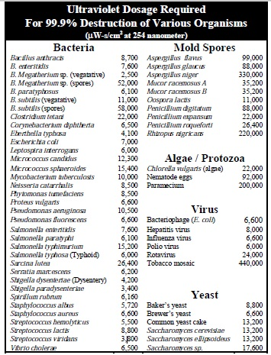
QED Disinfection of Water pathogens by body heat for 10 seconds
> 60 mJ/cm²
Disinfects:
All Bacteria / Yeast
and
Most Spores / Virus
Leptospira
Endocrine disruptors [O3]
15

Slide 19
Results
Tests are ongoing.
Very encouraging, but cannot report at this time.
Updates are reported on my home page
20

Slide 20
Collaboration
The applications of QED induced UV-C radiation in the disinfection of infectious diseases are numerous and diverse, the development and testing of which is beyond the capability of the author.
Collaboration with interested parties is solicited.
21

Slide 21
Questions & Papers
Email: nanoqed@gmail.com
http://www.nanoqed.org
22
Notes:
Enter speaker notes here.

