Slide 1
Validity of Molecular Dynamics in Computational Nanoscience
Thomas Prevenslik
QED Radiations
Discovery Bay, Hong Kong, China

Slide 2
Introduction
Molecular Dynamics MD is commonly used to simulate heat transfer at the nanoscale in the belief:
Atomistic response using L-J potentials (ab initio) is more accurate than macroscopic finite element FE programs, e.g., ANSYS, COMSOL, etc.
In this talk, I show:
FE gives equivalent heat transfer to MD, but both are invalid at the nanoscale by quantum mechanics QM
And present:
NW Tensile Test as an example of valid MD solutions by QM
1

Slide 3
MD and FE Restrictions
MD and FE are restricted by SM to atoms having thermal heat capacity
SM = statistical mechanics
2

Slide 4
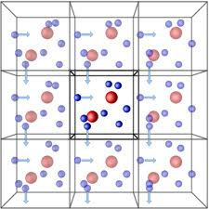
Validity
Classical MD simulations of the bulk performed under PBC assume atoms have heat capacity
Metropolis & Teller, J. Chem. Phys., 21, pp 1087-1092, 1953.
In the macroscopic bulk being simulated, all atoms do indeed have heat capacity
MD is therefore valid for bulk PBC simulations
3

Slide 5
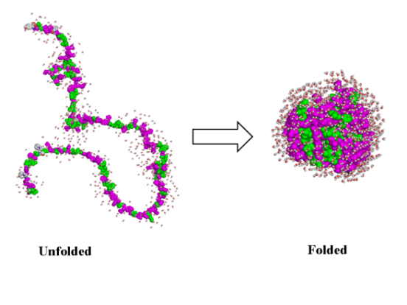
Problem
Today, MD is not used for bulk simulations, but for the response of discrete molecules and nanostructures
MD programs based on SM assume the atom has heat capacity, i.e., temperature changes in folding proteins.
But QM forbids temperature changes → MD invalidity
Protein Folding
4

Slide 6
Heat Capacity of the Atom
Classical Physics (MD, Comsol, ANSYS)
Classical Physics (MD, Comsol, ANSYS)
kT 0.0258 eV
QM
(kT = 0)
In nano structures, the atom has no heat capacity by QM
5

Slide 7
Quantum Corrections
The vanishing heat capacity in the Planck law of QM is consistent with making QCs of heat capacity to MD solutions.
QC = quantum corrections
Allen and Tildesley - Computer Simulations of Liquids, 1987.
Berens et al., J. Chem. Phys. 79, 2375,1983
QCs show heat capacity vanishes in MD, but is ignored.
McQuarrie, 1976 – misinterpreted QCs
Invalid MD solutions throughout the literature
6

Slide 8
Conservation of Energy
Lack of heat capacity by QM precludes EM energy conservation in discrete molecules and nanostructures by an increase in temperature, but how does conservation proceed?
Proposal
Absorbed EM energy is conserved by QED creating EM radiation that charges the discrete molecule and nanostructure or is lost to the surroundings.
7

Slide 9
EM Confinement
Nano structures have high surface to volume ratio →
Absorbed EM energy concentrated in the surfaces temporarily traps itself to form the EM confinement
QED converts the trapped EM energy to standing wave QED radiation that is emitted to surrounding
f = ( c/n) / λ λ / 2 = d E = h f
Nano
Coating
QED
Radiation
QED
Radiation
Heat
Body
Surroundings
d = λ/2
No
Temperature
increase
8

Slide 10
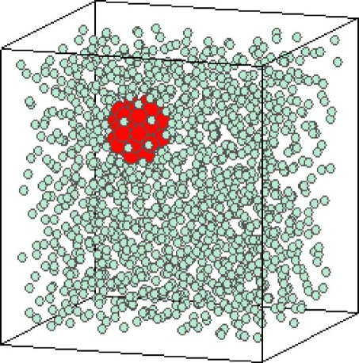
MD - Discrete and PBC
Akimov, et al. “Molecular Dynamics of Surface-Moving Thermally Driven Nanocars,”
J. Chem. Theory Comput. 4, 652 (2008).
Sarkar et al., “Molecular dynamics simulation of effective thermal conductivity and study of enhance thermal transport in nanofluids,”
J. Appl. Phys, 102, 074302 (2007).
MD for Discrete → kT = 0
But MD assumes kT > 0
Car distorts but does not move
Macroscopic analogy
FE Simulations → Same as MD
Classical Physics does not work at nanoscale
QM differs
No increase in car temperature
Charge is produced
Cars move by electrostatic interaction
MD for kT > 0 is valid for PBC because atoms in macroscopic nanofluid have kT > 0
9

Slide 11
NW in Tensile Test NW = Nanowire
Stiffening of NWs at Georgia Tech- Prof. Wang.
"Size effects on elasticity, yielding, and fracture of silver nanowires: In situ experiments,” Phys. Rev. B, 85, 045443, 2012.
Mechanism: high surface to volume ratio in combination with the annihilation of dislocations from fivefold twinning?
Proposed Mechanism
QM denies the NW the heat capacity to increase in temperature from grips in tensile tests →
Atoms are charged
10

Slide 12
MD Model
L
z
w
F
F
w
The NW 38 nm diameter x 1.5 micron long
Modeled in smaller size of 550 atoms in the FCC configuration
The NW sides w = 8.18 Ȧ and length L = 87.9 Ȧ.
11

Slide 13
Lennard-Jones Potential
The L-J potential simulated the atomic potential U_{ij}
$U_{ij}=4ε\left[{\left(\frac{σ}{R_{ij}}\right)}^{12}−{\left(\frac{σ}{R_{ij}}\right)}^{6}\right]$
For silver, σ = 2.644 Ȧ and ε = 0.345 eV.
12

Slide 14
Electrostatic Energy
To obtain valid MD solutions, replace thermal energy UkT of the atom by the QED electrostatic energy UES
Coulomb repulsion between all atoms
$$F_{ij}=η\frac{e^{2}}{4ε_{o}R_{ij}^{2}}$$
$$U_{kT}=\frac{3}{2}kT_{grip}$$
$$U_{ES}=\frac{3e^{2}}{20ε_{o}R_{atom}}$$
$$=\frac{U_{kT}}{U_{ES}} =\frac{10ε_{o}k{R_{atom}T}_{grip}}{e^{2}}=0.0065 at 300 K$$
13

Slide 15
Equilibration
The MD model is equilibrated by running for 5000 iterations maintaining a temperature of 0.01 K with the Nose-Hoover thermostat and a time step < 5 fs.
Loading
The axial stretching of the NW was simulated imposing a step displacement Δ and holding the displacement for 5000 iterations.
$$F=\frac{AE}{L}Δ$$
14

Slide 16
Stress Computation
The σ_{x}, σ_{y}, and σ_{z} stresses are computed virial theorem,
$$_{ij}^{V}= \frac{1}{V}\sum_{}{\left[\frac{1}{2}\sum_{β=1}^{N}{\left(R_{i}^{}−R_{i}^{β}\right)F_{j}^{β}}−m^{}v_{i}^{}v_{j}^{}\right]}$$
The thermal velocity $v_{i}^{}$ of the atoms is required to be included in the virial, but sometimes is not ?
Resolved by QM
Atoms in the NW are not thermally excited
15

Slide 17
NW in Uniaxial Tension (Traditional MD - Macroscale Tensile Test)
16

Slide 18
NW in Triaxial Tension (MD by QM – Nanoscale Tensile Test)
17

Slide 19
Summary
NW fits data at η = 0.001 means 1/6.5 = 15 % of the kT energy stiffens the NW, the remaining 85% lost to surroundings.
In the uniaxial stress state, Young’s modulus Yo ~ 17 x 10⁶ psi
In the triaxial stress state, Young’s modulus Y ~ 31x10⁶ psi
The stiffening enhancement is Y/Yo ~ 1.88.
18

Slide 20
Conclusions
MD based on SM is valid for PBC
MD and FE provide equivalent heat transfer simulations of molecules and discrete nanostructures, but invalid by QM
QM negates SM and thermal conduction at the nanoscale, i.e., Fourier’s equation not applicable
Valid MD of molecules and nanostructures require conservation of absorbed EM energy by the creation of charge instead of temperature.
19

Slide 21
Questions & Papers
Email: nanoqed@gmail.com
http://www.nanoqed.org
20
Notes:
Enter speaker notes here.

