Slide 1
Disinfection of Ebola in the Developing World
Thomas Prevenslik
QED Radiations
Discovery Bay, Hong Kong
1
Notes:
Enter speaker notes here.

Slide 2
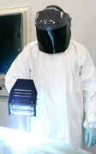
Introduction
The Ebola virus is a worldwide concern. In the United States, Ebola disinfection includes electric powered hand-held systems that produce a UV-C radiation
UV-C = Ultraviolet at 254 nm
The protocol for Ebola disinfection in the U.S. is too complex and costly in the developing world requiring unavailable sources of electricity.
2

Slide 3
Proposal
QED induced EM radiation from body heat in a hand-held nano-coated bowl called an EBOELA is proposed to provide the UV- C to inexpensively disinfect Ebola without electricity.
QED = quantum electrodynamics
EM = electromagnetic.
3

Slide 4
Operating Principle
The EBOWLA converts body heat from the hand holding the bowl to UV-C radiation because the temperature of the nano-coating cannot increase by QM.
QM = Quantum Mechanics
4

Slide 5
Nano Coating
Applying a nano coating to a surface avoids natural convection and conserves heat by emission of QED radiation instead of the usual temperature increase
Suggesting:
QED is the FOURTH mode of Heat Transfer?
( 3 modes known: Conduction, Radiation, Convection)
5

Slide 6
4th Mode of Heat Transfer
Natural convection
QED Radiation
Macro Coating > 1 micron
Nano Coating < 100 nm
Substrate
Body heat
Nano Coating avoids natural convection and conserves Body heat by QED radiation instead of a temperature increase
6

Slide 7
Theory
Heat Capacity of the Atom
Conservation of Energy
TIR Confinement
7

Slide 8
Heat Capacity of the Atom
Classical Physics (kT > 0)
kT 0.0258 eV
QM
(kT = 0)
Nanocoatings
In nano coatings, the atom has no heat capacity by QM
8

Slide 9
Conservation of Energy
Lack of heat capacity by QM precludes EM energy conservation in nano coatings by an increase in temperature, but how does conservation proceed?
Proposal
Absorbed EM energy is conserved by creating QED radiation in the nano coating - by frequency up - conversion to the TIR resonance of the nano coating
TIR = Total Internal Reflection
9

Slide 10
TIR Confinement
If the RI of nanocoating is greater than that of surroundings, the proposed QED radiation is confined by TIR
RI = refractive index
Nano coatings have high surface to volume ratio.
EM energy is absorbed almost totally in the coating surface.
QED radiation is created upon EM energy absorption.
f = c/λ λ = 2nd E = hf
d = coating thickness
10

Slide 11
Application
Analysis
Coating Selection
Body Heat
Disinfection Dosage
11

Slide 12
Analysis
UV-C requires ZnO thickness about 50 nm
12

Slide 13
Coating Selection
Insuring TIR confinement requires the RI of the coating to be greater than that of the substrate.
For ZnO coating having n = 2.5, the QED emission from 50 nm thicknesses produces EM radiation from UV-C at 254 nm may be transmitted in air to near surfaces without absorption
13

Slide 14
Body Heat
Total human body heat is about 100 W.
Since the average surface area for adult men and women is about 1.75 m², the body heat Q is,
Q = 57.1 W/m². = 5.71 mW / cm².
14

Slide 15
Disinfection Dosage
UV light as a disinfectant penetrates an organism’s cell walls and scrambles the genes to preclude reproduction. The optimum UV wavelength range to destroy bacteria is between 250 and 270 nm.
UV-C = 254 nm
The minimum UV-C dose necessary to destroy the Ebola virus is 0.4 mJ / cm².
For Q = 5.71 mW / cm² , the Ebowla moved in 1 second scans is more than capable of disinfecting the Ebola virus.
15

Slide 16
Status
The QED induced disinfection of drinking water is currently under development.
Prototypes comprise a 1 mm thick half-sphere aluminum bowls (100 mm diameter x 50 mm high) that fit into the palm of one hand to take advantage of the 12 C differential between body temperature (32 C) and ambient (20 C).
16

Slide 17
EBOWLA
17

Slide 18
Proof of Principle
Proof of the QED principle at UV-A levels for titanium dioxide are ongoing.
For UV-A (330 – 400 nm), the TiO₂ having RI = 2.6 requires thicknesses (63 – 73 nm).
The TiO₂ coatings are applied to flat 20 mm x 20 mm aluminum samples and heated on the backside by an insulated electrical heater.
18

Slide 19
Conclusions
The EBOWLA is suited for disinfecting Ebola in the developing world that lacks sources of electricity. Costs are minimal allowing free distribution by governments to individuals.
Once exposed to the virus, Ebola workers discard protective suits– an expensive procedure in West Africa. By adding an appropriate nano coating, the suits continually emit UV-C to remove attached Ebola viruses and allow re-use.
19

Slide 20
Extensions
Drinking Water
Smartphones
Hand Rails & Poles
20

Slide 21
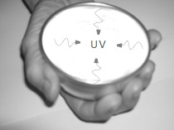
Drinking Water Disinfection
21

Slide 22
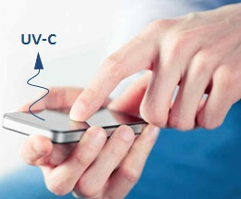
Smartphones
22

Slide 23
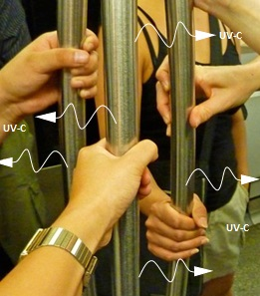
Public Transportation
23

Slide 24
Collaboration
The applications of QED induced UV-C radiation in the disinfection of infectious diseases are numerous and diverse, the development of which is beyond the capability of the author.
Collaboration with interested parties is solicited.
24

Slide 25
Questions & Papers
Email: nanoqed@gmail.com
http://www.nanoqed.org
25
Notes:
Enter speaker notes here.

