Slide 1
Neuron Synapse by Quantum Mechanics
Thomas Prevenslik
QED Radiations
Discovery Bay, Hong Kong
Notes:
Enter speaker notes here.

Slide 2
Introduction
Mainstream theory of neurons is based on chemical signaling by neurotransmitters (NTs) injected into the cleft (exocytosis)
Chemical signaling is based on by the “lock and key” mechanism of olfaction (smell) whereby the postsynaptic receptors (lock) only accept the precise shape of the NT molecules (key).
1

Slide 3
Chemical Signaling
Pre Synaptic Cell
Post Synaptic Cell
NT Molecules
Cleft
Vesicle
Receptors
Lock
and
Key
2

Slide 4
Problems
Chemical signaling requires the NT molecule find and then bind to the receptor and continues until dissociating from the receptor.
Binding requires the NT (keys) precisely fit in the receptor (locks).
Once NTs dissociate from the receptor:
enzymes are required to make them nonfunctional
and
the NTs must be removed from the cleft prior to the next action potential.
3

Slide 5
Proposal
EM signaling instead of chemical signaling
in an Exo/Endo cycle by the NTs emitting a burst of radiation corresponding to their unique EM spectrum
The EM signal terminates itself thereby avoiding:
the finding and binding of NT molecules to receptors
2. enzymes to make the NT molecules remaining in the cleft nonfunctional
3. the removal of NT molecules prior to the next action potential
4

Slide 6
Exo-Endo Cycle
Experiments suggest signaling occurs in a prompt Exo/Endo Cycle described as a “walk, kiss, pause … then run” process
Vesicle fusion at the cell membrane is rapid.
Hence, vesicles may remain essentially intact during exocytosis
5

Slide 7
EM Signaling
Pre Synaptic Cell
Post Synaptic Cell
Cleft
Vesicle
QED Radiation
Receptors
NT Molecules
6

Slide 8
QED Induced Radiation
In the presynaptic cell, the NTs acquire the thermal kT energy.
But isolation at exocytosis leaves the NTs with thermal kT energy not allowed by QM. Also, QM requires the heat capacity of the NTs to vanish precluding conservation by an increase in temperature.
Conservation proceeds by the NTs emitting a burst of QED radiation given by their EM spectra, thereby providing a unique EM signal for receptors.
How possible by QM?
7

Slide 9
Classical v. QM Heat Capacity
Classical Statistical Mechanics
kT 0.0258 eV
QM
Nanoscale
8

Slide 10
NT and NP Emission
EM Spectrum
TIR frequency
NT molecule
NP Continuum
9

Slide 11
TIR Confinement
EM energy is conserved by QED induced frequency up-conversion to the TIR confinement frequency of the NP.
Since NPs have high surface to volume ratios, absorbed EM energy of any form is confined by TIR almost entirely in the NP surface.
The TIR confinement is momentary and occurs only upon absorption of EM energy, and therefore the TIR confinement effectively sustains itself.
10

Slide 12
EM Signaling
QED radiation induces the NTs to emit their EM spectra
To illustrate QED radiation in NTs, consider a NP of diameter D and refractive index n. The QED photon energy E, frequency f, and wavelength λ are:
E = h f f = ( c / n ) / λ λ = 2D
The NP energy U is dependent on the diameter D and number N_{A} of atoms having a cubical spacing Δ is,
$U$ = $\frac{3}{2}$ k T NA = $\frac{π}{4}$ k T ${\left(\frac{D}{Δ}\right)}^{3}$
The number N of QED photons / burst is N = U / E
11

Slide 13
QED Photon Energy E and Number N
QED photons available for EM signaling
12

Slide 14
Conclusions
QED induced radiation in EM signaling is a reasonable alternative to chemical signaling in that problems with finding, binding and unbinding NT molecules to receptors are avoided.
The simpler EM signaling compared to chemical signaling presupposes Nature agrees.
13

Slide 15
QED Extensions
Molecular Dynamics
Heat transfer simulations invalid for discrete nanostructures
Big Bang Theory QED Redshift in cosmic dust means Universe is not expanding
14

Slide 16
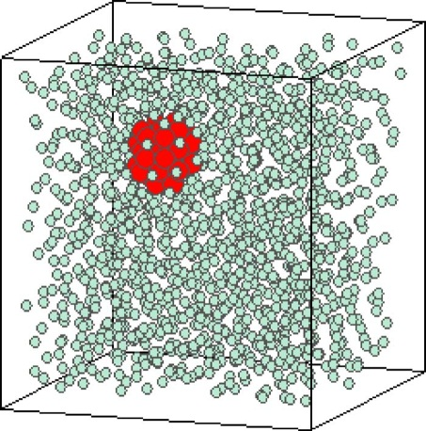
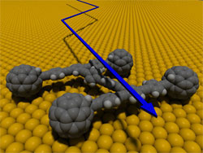
Molecular Dynamics
Akimov, et al. “Molecular Dynamics of Surface-Moving Thermally Driven Nanocars,”
J. Chem. Theory Comput. 4, 652 (2008).
Discrete → kT = 0, but kT > 0 assumed
Car distorts but does not move
Macroscopic analogy
Instead, QM forbids any increase in car temperature. Hence, QED radiation is produced that by the photoelectric effect charges the cars that move by electrostatic interaction with each other.
Sarkar et al., “Molecular dynamics simulation of effective thermal conductivity and study of enhance thermal transport in nanofluids,”
J. Appl. Phys, 102, 074302 (2007).
Periodic Boundary Conditions
kT > 0, valid
Metropolis & Teller, 1950
15

Slide 17
Big Bang Theory
In 1929, Hubble measured the redshift of galaxy light that based on the Doppler Effect showed the Universe is expanding.
However, cosmic dust which is submicron NPs permeate space and redshift galaxy light without Doppler effect.
16

Slide 18
QED Induced Redshift
Classical Physics – Absorbed galaxy photon increases NP temperature
17

Slide 19
Effect on Cosmology
The redshift: Z = (λ_{o} - λ)/λ > 0 occurs without the Universe expanding.
Astronomers will not find the dark energy to explain an expanding Universe which is not expanding
Suggests a return to a static infinite Universe once proposed by Einstein.
18

Slide 20
Questions & Papers
Email: nanoqed@gmail.com
http://www.nanoqed.org
19
Notes:
Enter speaker notes here.

